Slide 1
New Automation Technology Beckhoff Automation

Slide 2
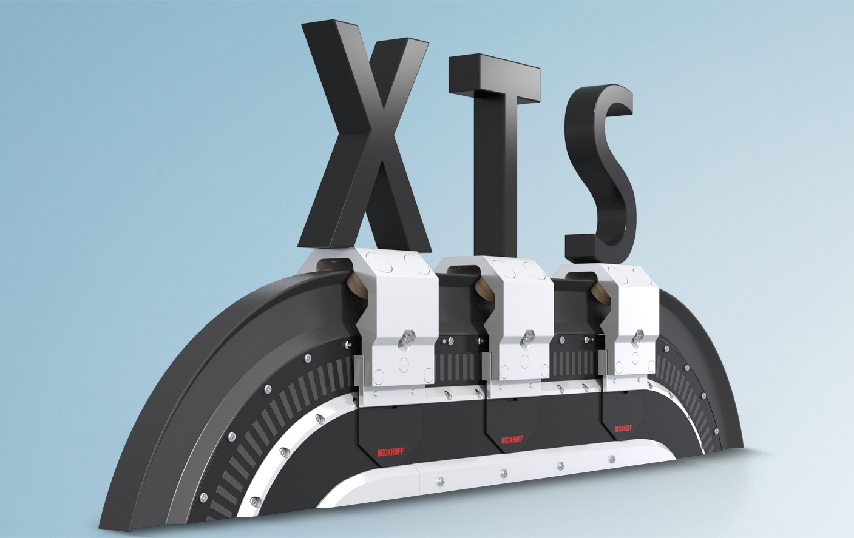
XTS Training

Slide 3

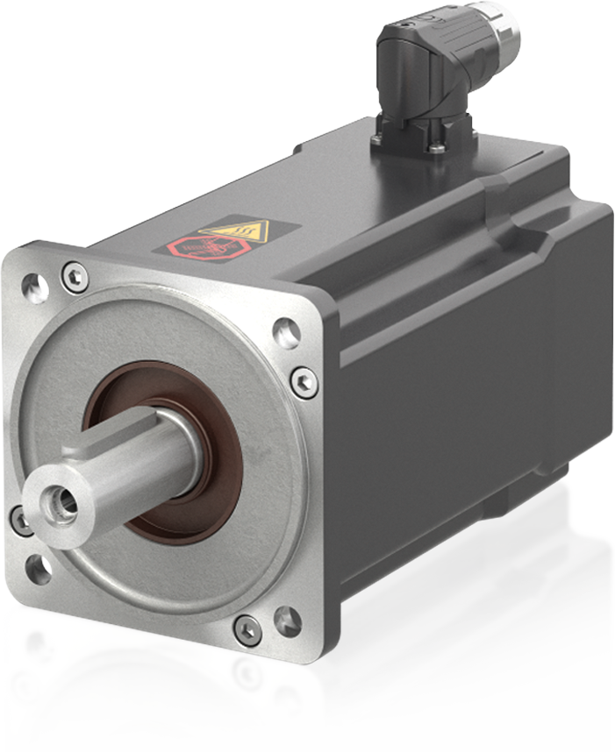
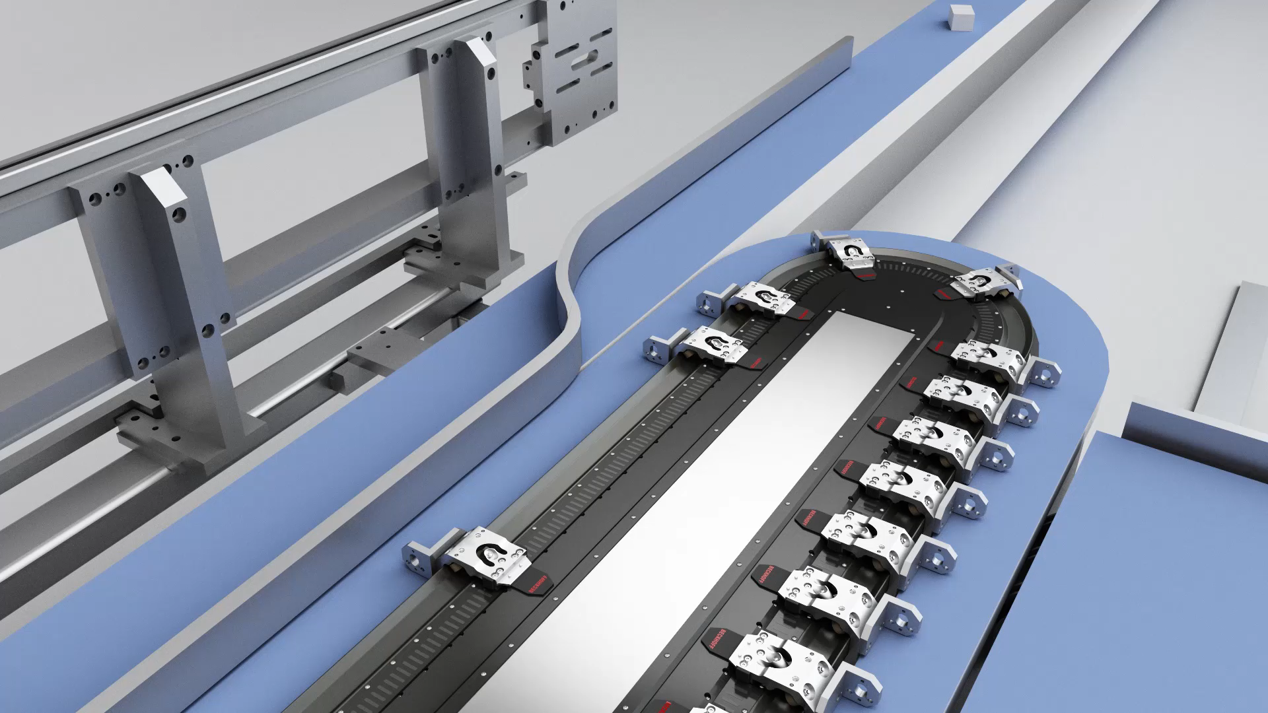
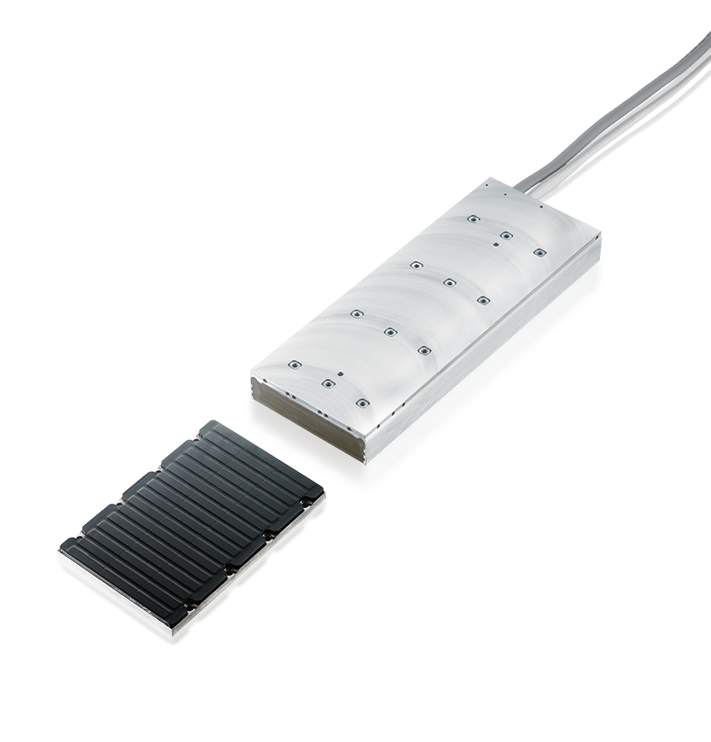
XTS | a new dimension for intelligent product transport
rotary
linear
Notes:
XTS combines advantages of rotary and linear systems

Slide 4
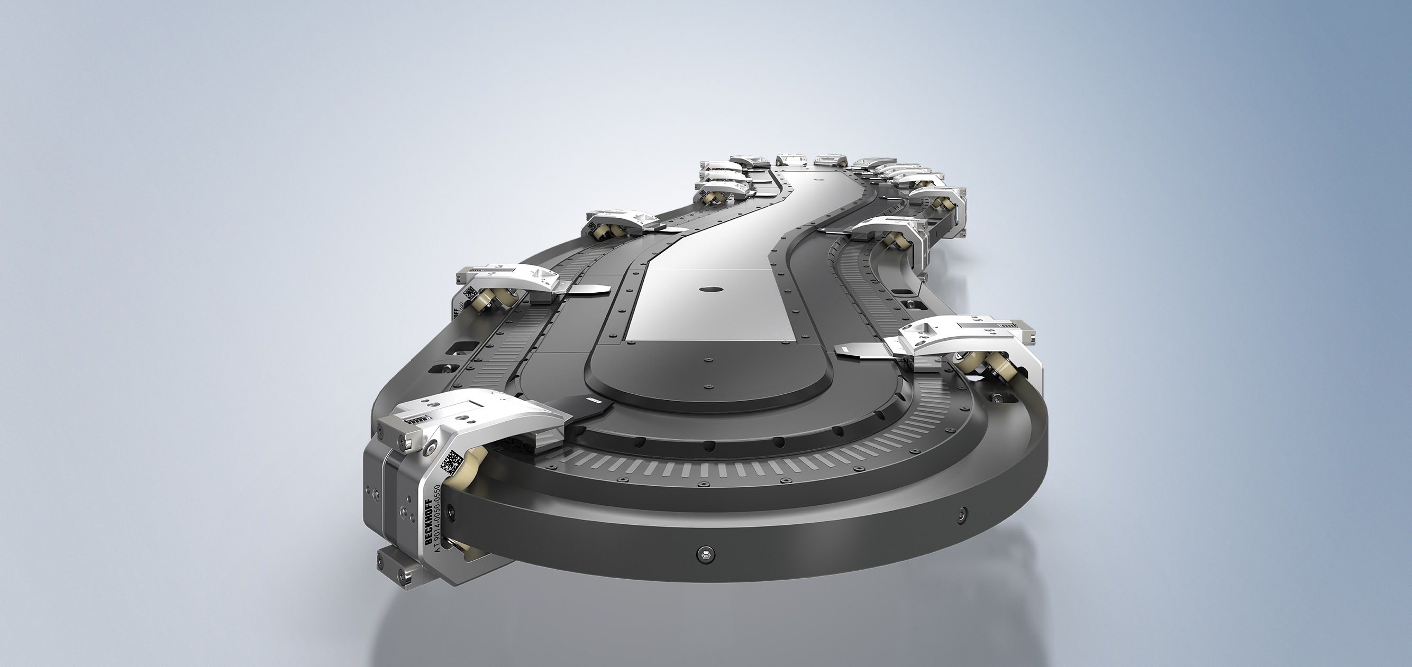
Agenda | XTS- Overview
System properties
XTS-StarterKit
XTS Module
Preparation and Assembly
First Test
Rail mounting
Rerailing of Mover

Slide 5
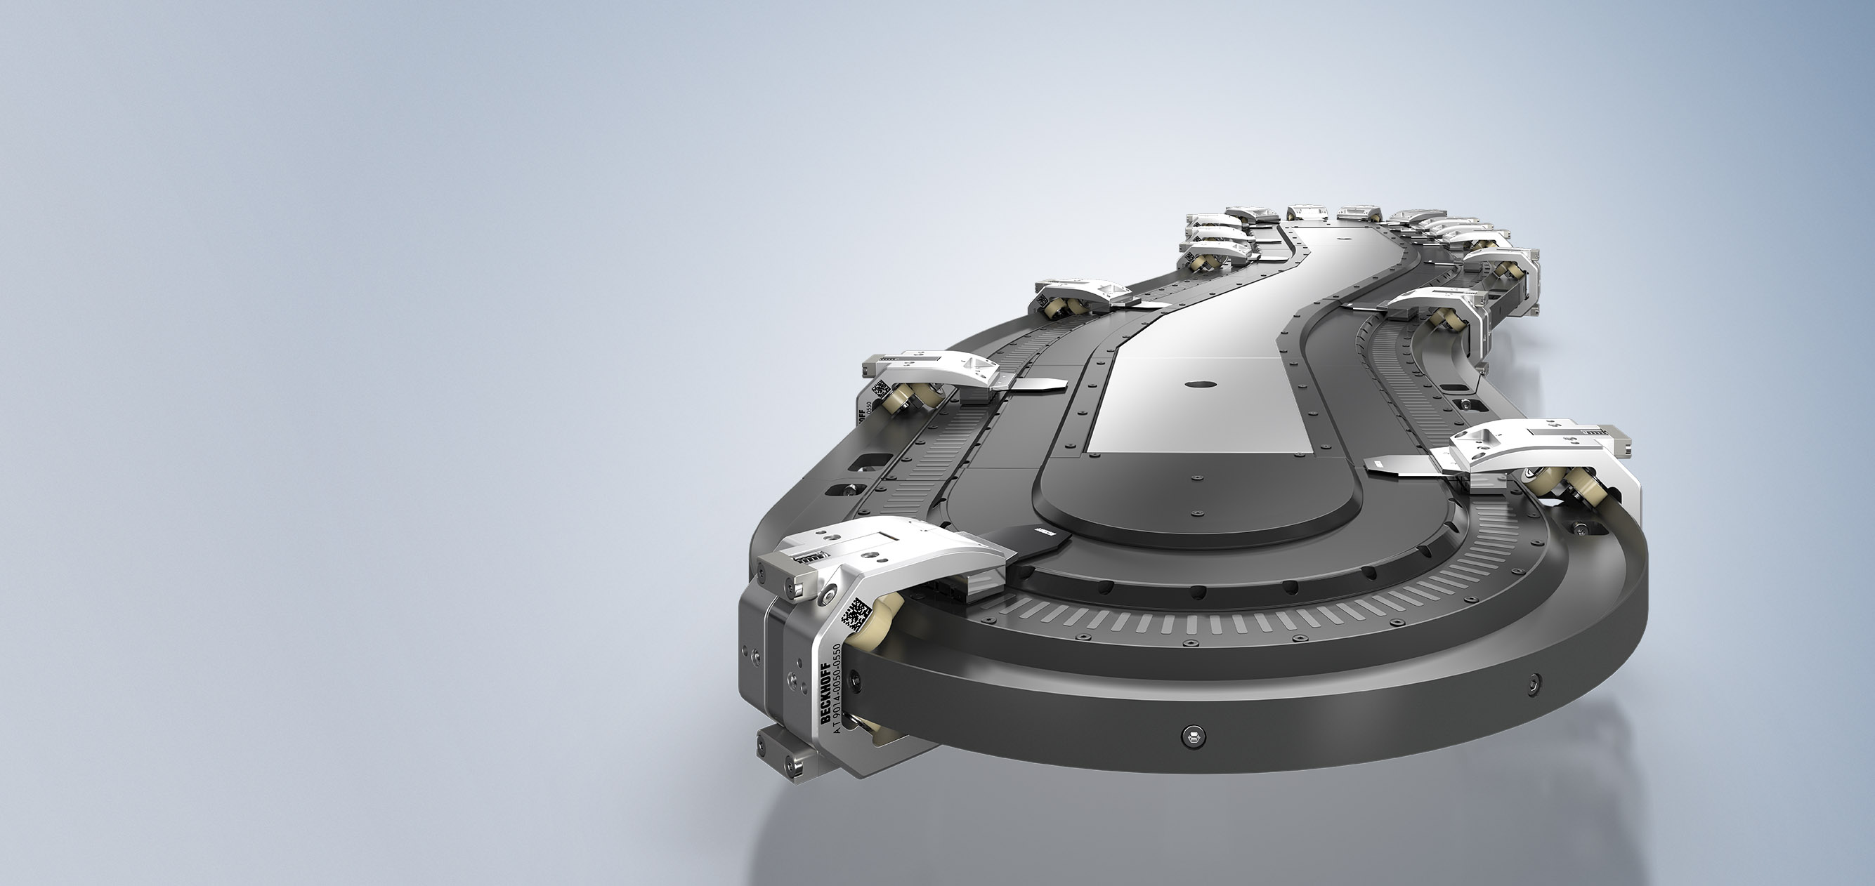
System properties
speed up to 4 m/s – acceleration up to 10 m/s²
20 kg payload, even more in coupled
operation
20
repeat accuracy
down to (±) 10 µm
center-to-center distance
of 50 mm possible
mover identification (standard and Mover 1)
1

Slide 6
XTS technical data
Alignment | horizontally, vertically or at any angle from 1…179°
Magnet pitch | ≥ 50 mm
Peak force | AT9001-x550 (5-pin): 100 N, AT9001-xAA0 (10-pin): 210 N | AT9001-x775 (7-pin): 130 N, (specifications refer to straight sections)
Continuous force | AT9001-x550 (5-pin): 30 N, AT9001-xAA0 (10-pin): 75 N | AT9001-x775 (7-pin): 45 N, (specifications refer to straight sections)
Max. speed | 4 m/s
Max. payload | up to 40 kg | higher loads with reduced dynamics possible
Max. acceleration | 10 g | without payload
Absolute accuracy | ±0.25 mm | within a straight module
Repeatability | < ±0.01 mm | standstill unidirectional
Synchronization accuracy | < ±0.15 mm | at 1.5 m/s within straight motor module
Max. system size | > 100 m, > 200 mover
IP protection rating | IP65 | in assembled condition for a closed system
Approvals/markings | CE, UL

Slide 7
Agenda | XTS- Assembly
XTS-StarterKit
XTS Module
Preparation and Assembly
First Test
Rail mounting
Rerailing of Mover

Slide 8
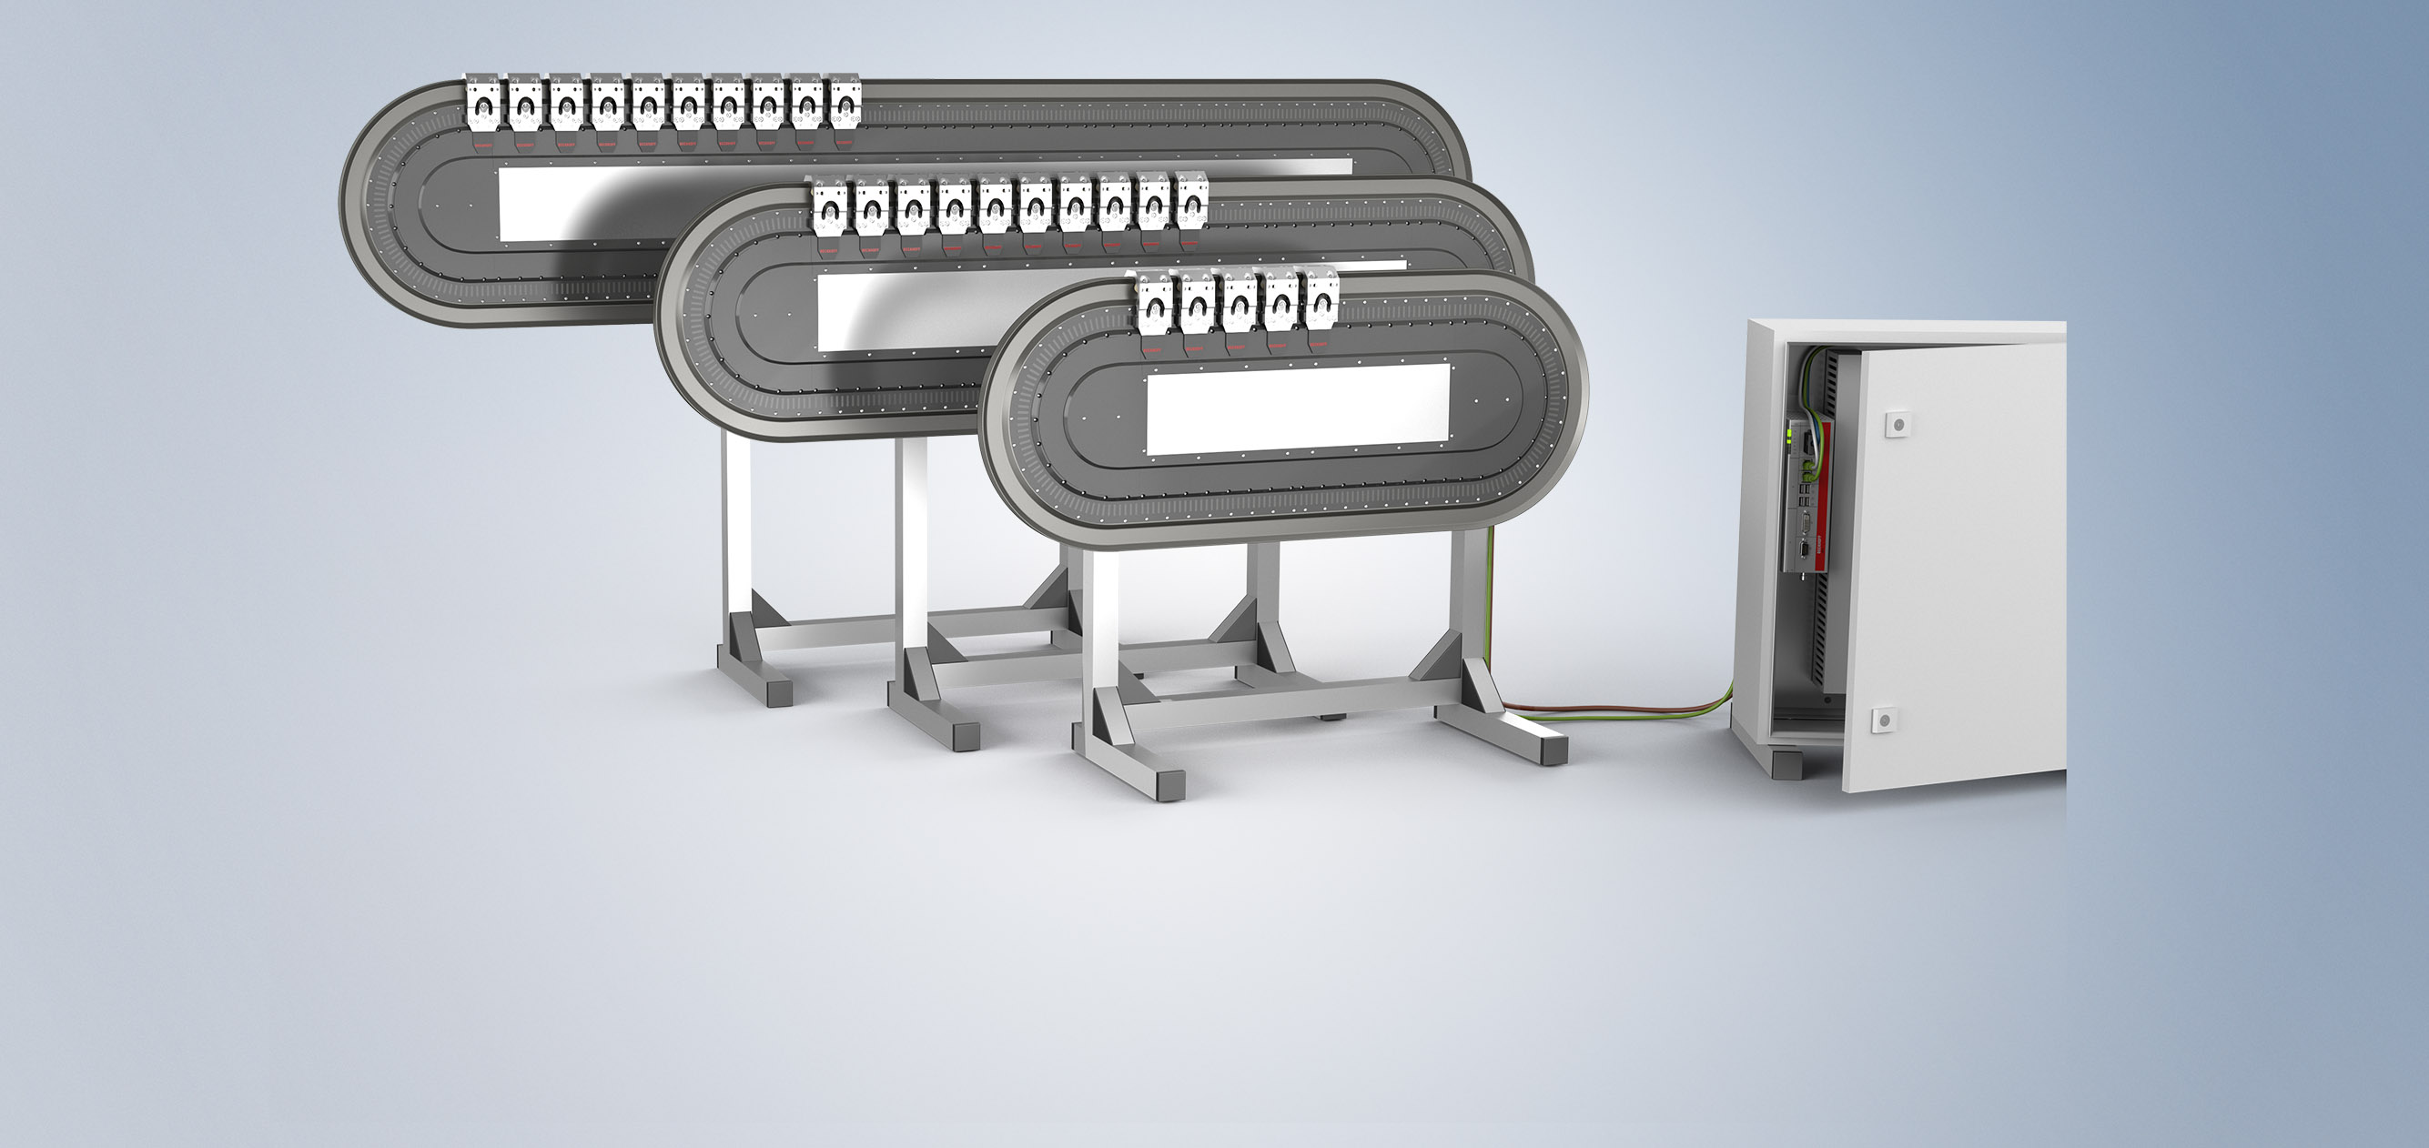
XTS StarterKit

Slide 9
XTS starter kits
XTS starter kits
plug-and-play solutions for office environments
XTS starter kits
first mover movements possible with little effort
XTS starter kits
one day of support and programming assistance

Slide 10
XTS starter kits
AT2000-0500
starter kit small, 500 mm straight length
AT2000-1000
starter kit medium, 1000 mm straight length
AT2000-1500
starter kit large, 1500 mm straight length

Slide 11
Agenda | XTS- Assembly
XTS-StarterKit
XTS Module
Preparation and Assembly
First Test
Rail mounting
Rerailing of Mover

Slide 12
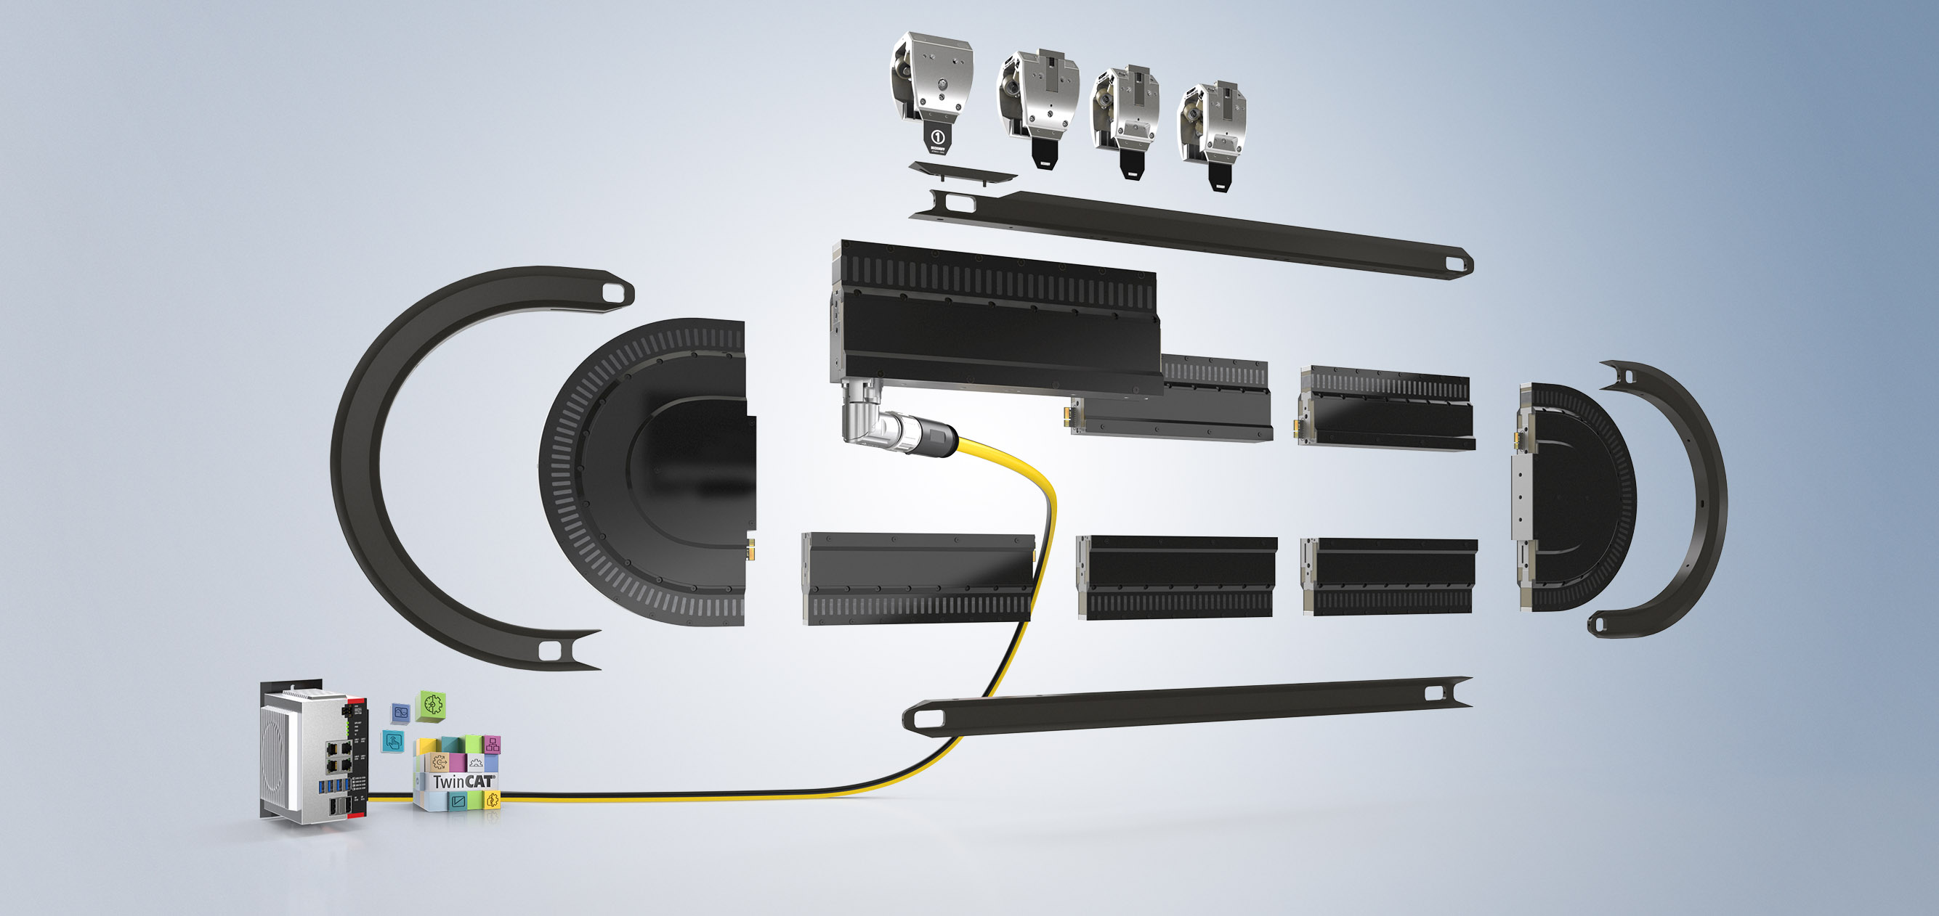
XTS Modules
Straight and curved motor module
Mover
Guide rail
Industrial PC with TwinCAT NC PTP, TwinCAT XTS Extension

Slide 13
XTS Modules The XTS motor module
Straight and curved motor module
Mover
Guide rail
Industrial PC with TwinCAT NC PTP, TwinCAT XTS Extension

Slide 14
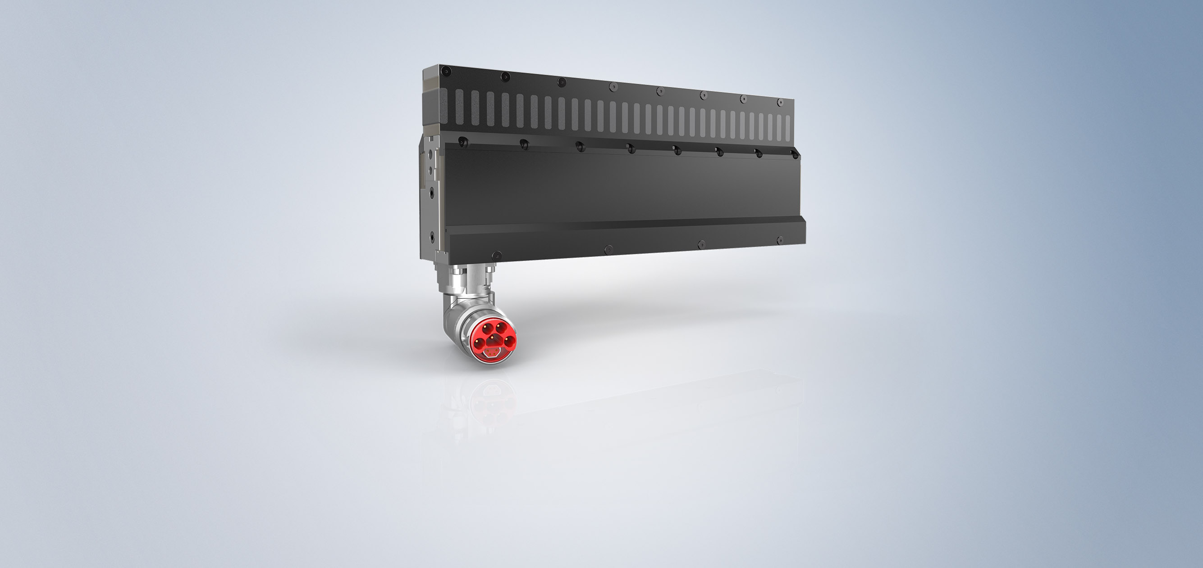
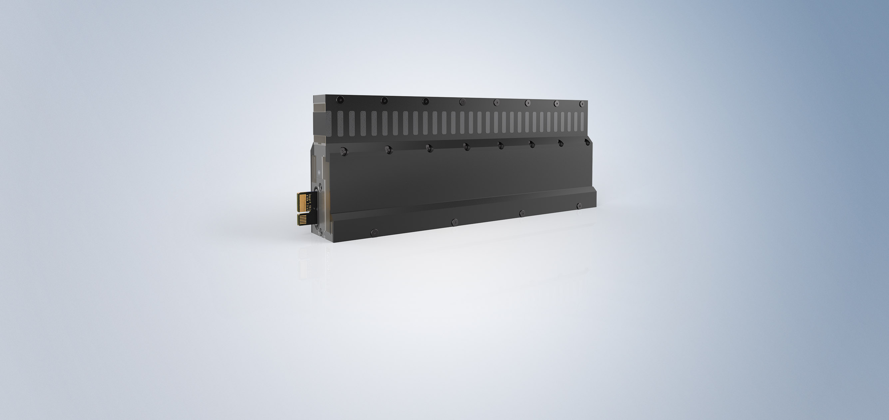
XTS Modules The XTS motor module
Fully integrated motor function and multi-position detection
Fully integrated power supply and data communication
Fully integrated interface for machine bed and guide rail

Slide 15
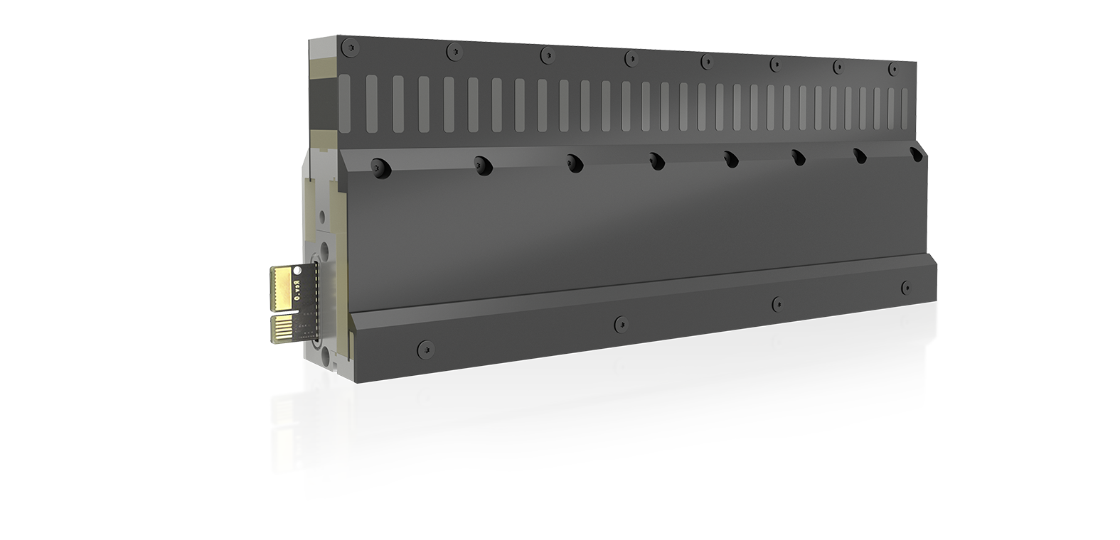
XTS Modules The XTS motor module
motor, coil package
mechanical interface for the guide rail
EtherCAT and power supply
(control: 24 V DC, power: 48 V DC)
mechanical interface for the support structure
power electronics and displacement measurement

Slide 16
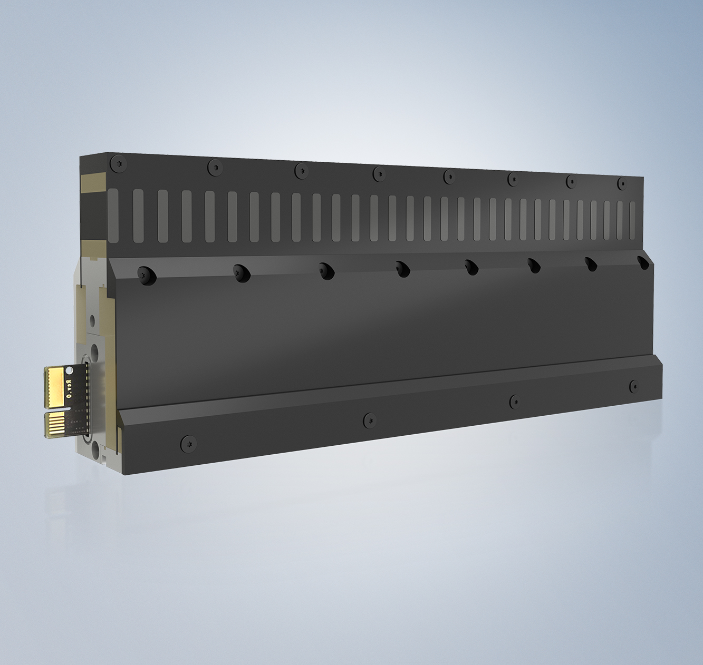
XTS Modules The XTS motor module
power supply, EtherCAT
motor modules with/without supply cables
supply can be connected internally across motor modules
supply voltage in the protective low voltage range
power electronics
output stages integrated in coil package
temperature monitoring of output stage
temperature model of the coils for optimum peak load utilization (I²T model)

Slide 17
XTS Modules The XTS motor module
position feedback
non-contact position detection with an encoder flag attached to the mover
absolute accuracy of ± 0.25 mm
positions are available immediately after switching on
→ no homing necessary
multi-position detection: no position restrictions even at the module limits

Slide 18
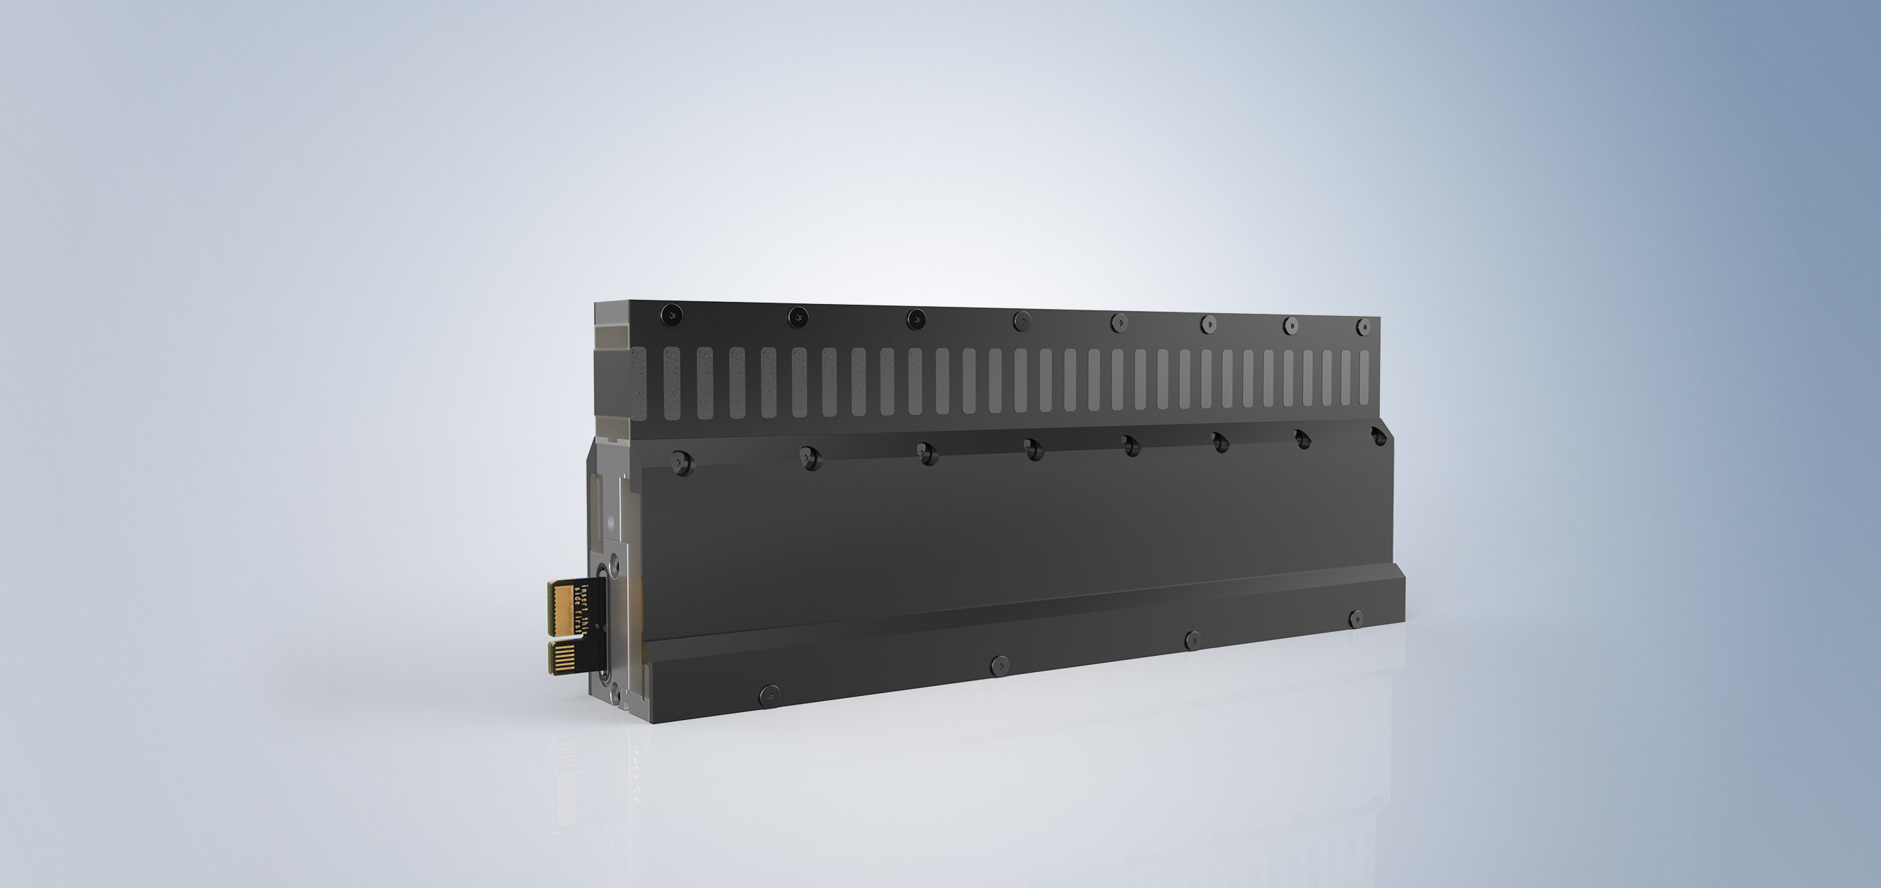
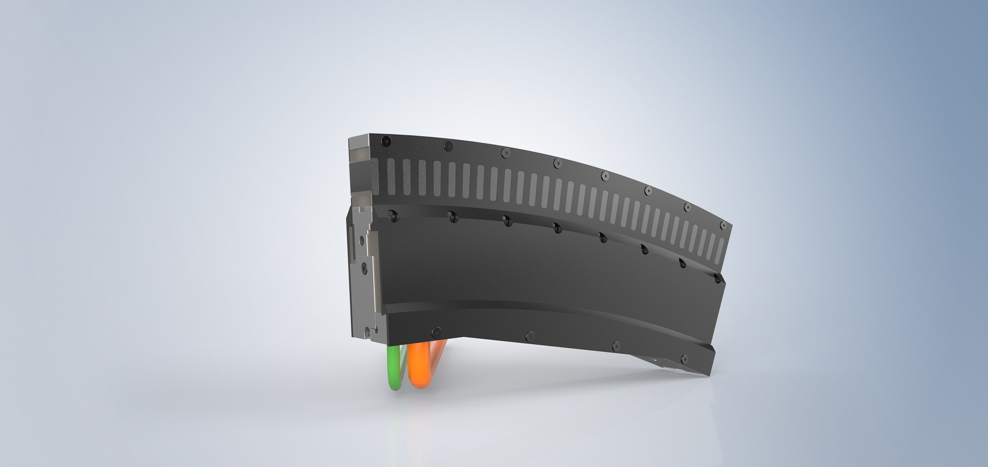
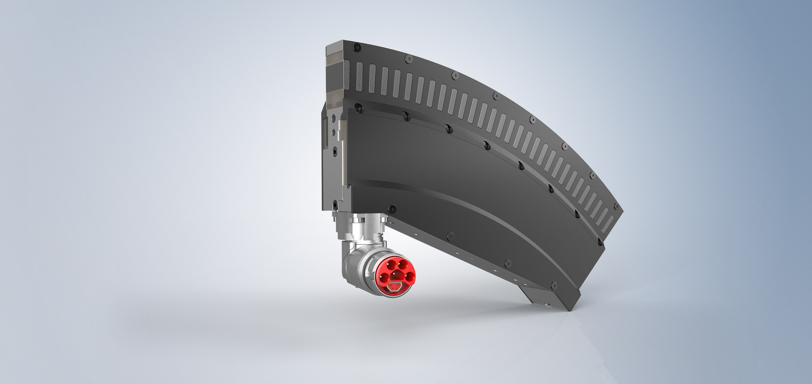
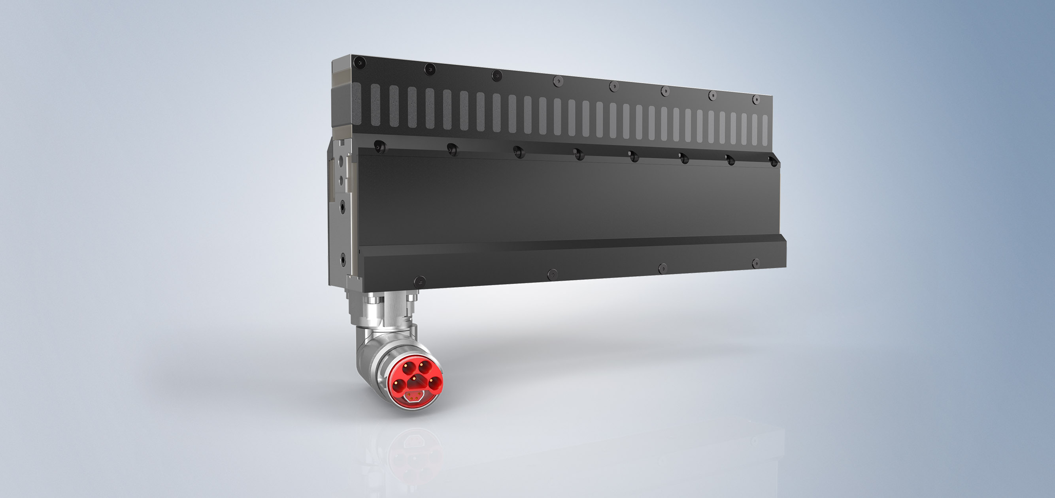
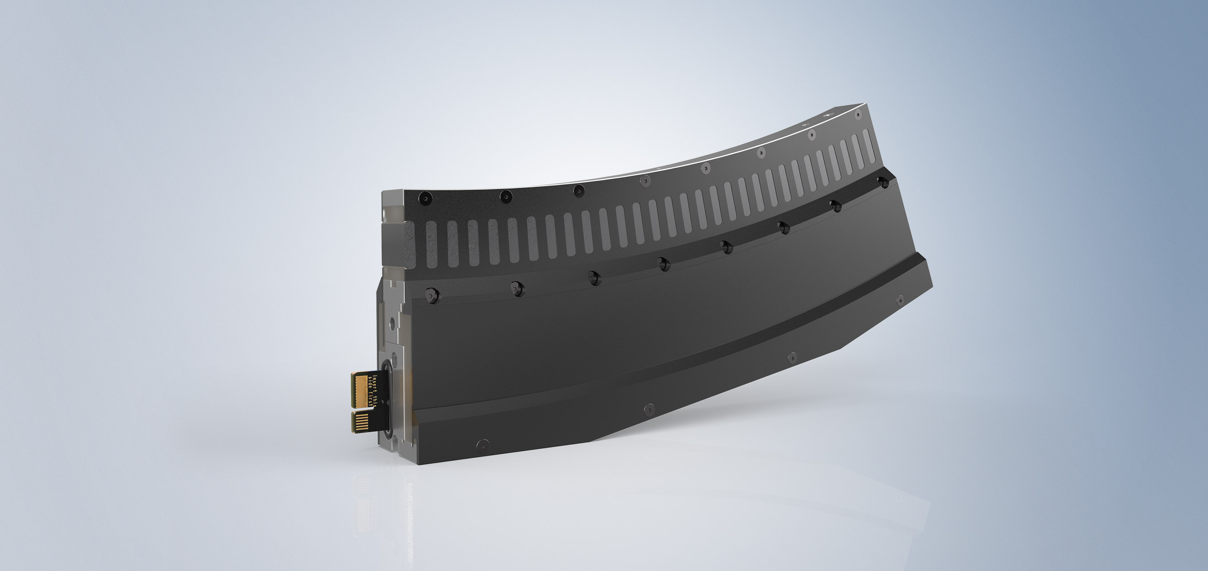
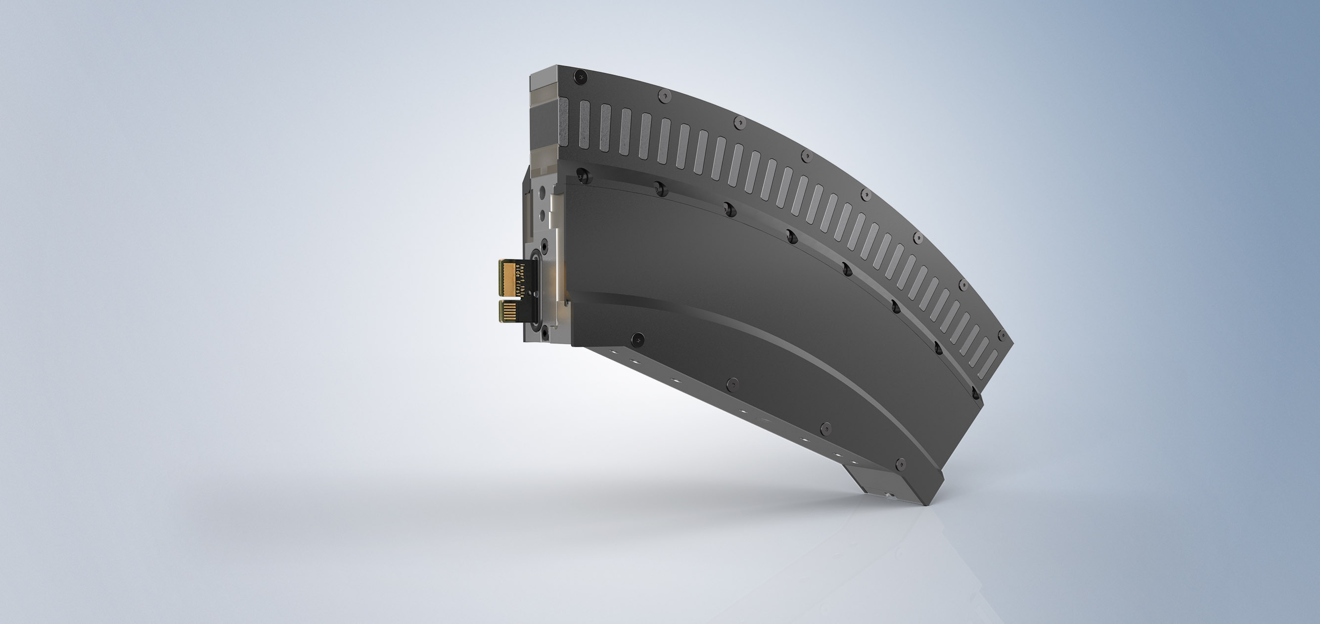
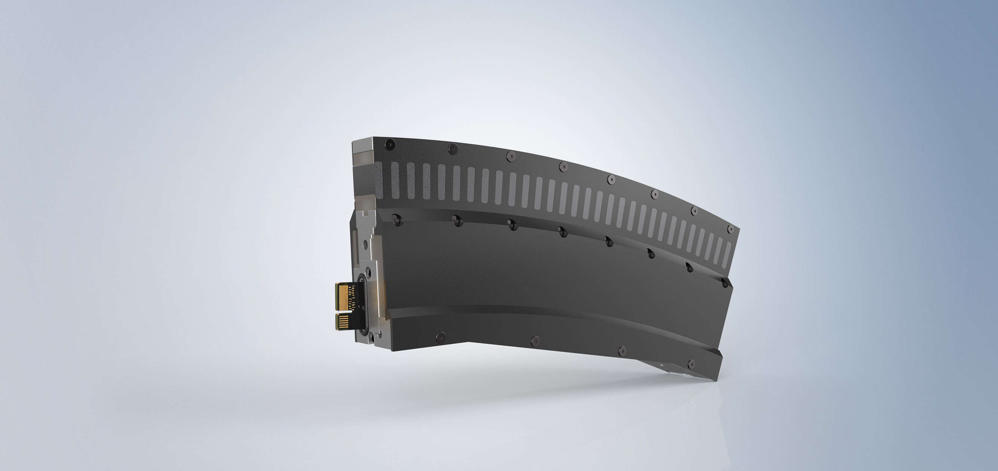
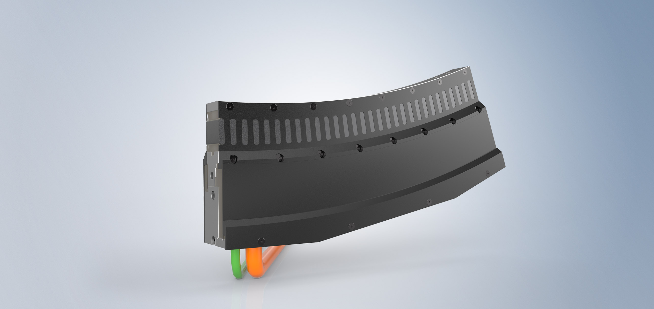
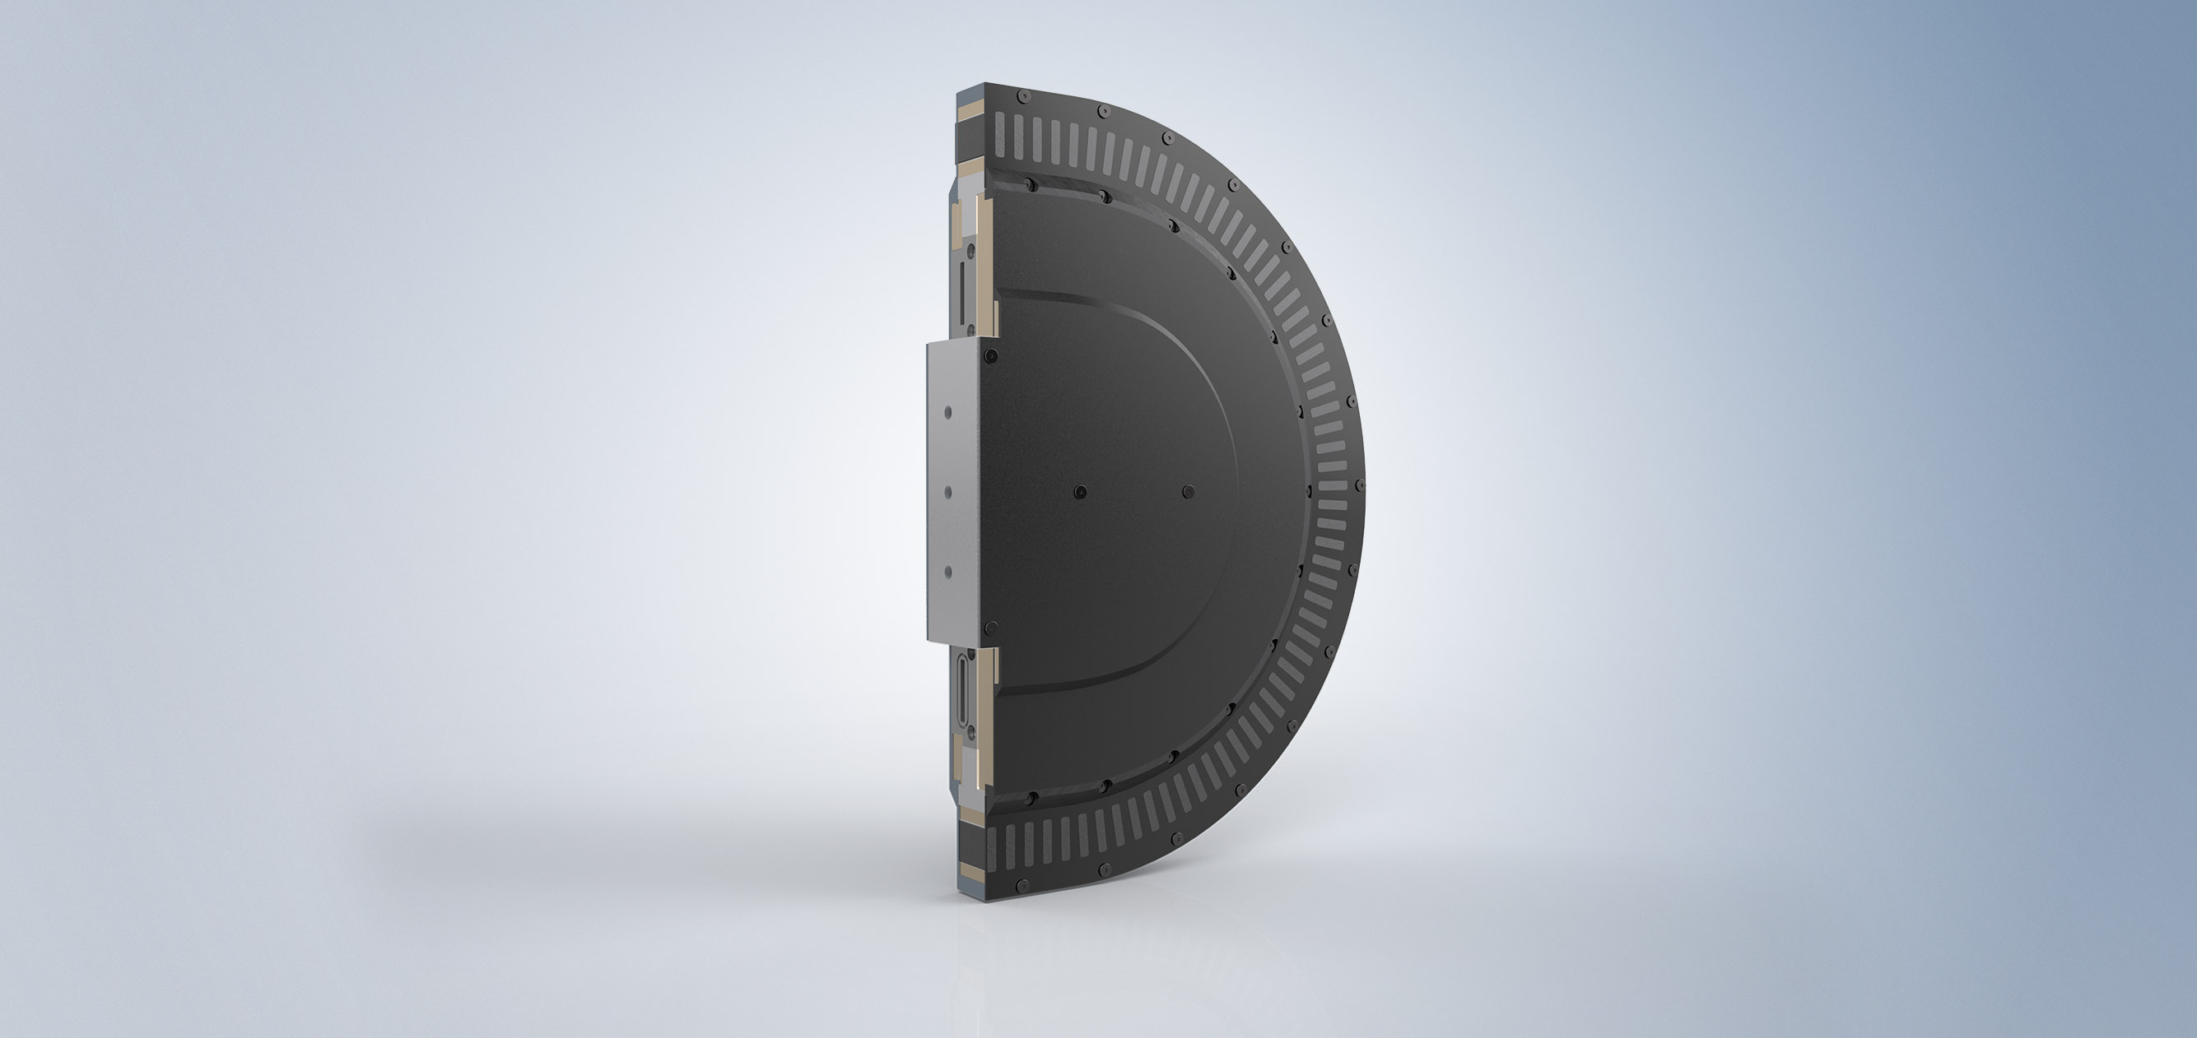
XTS Modules The XTS motor module

Slide 19
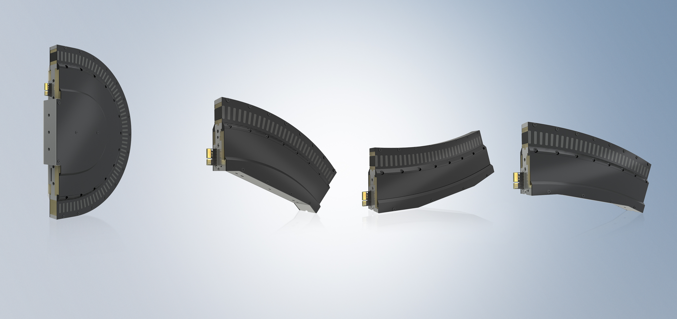
XTS Modules The XTS motor module / Other geometries
180° curve (clothoid) in 500 mm
45° curve in 250 mm for Ø 637 mm
-22.5° curve in 250 mm for Ø 1273 mm
22.5° curve in 250 mm for Ø 1273 mm

Slide 20

XTS Modules The XTS motor module /Flexible track layouts

Slide 21
XTS Modules System solution – mover and guide rail
Straight and curved motor module
Mover
Guide rail
Industrial PC with TwinCAT NC PTP, TwinCAT XTS Extension

Slide 22
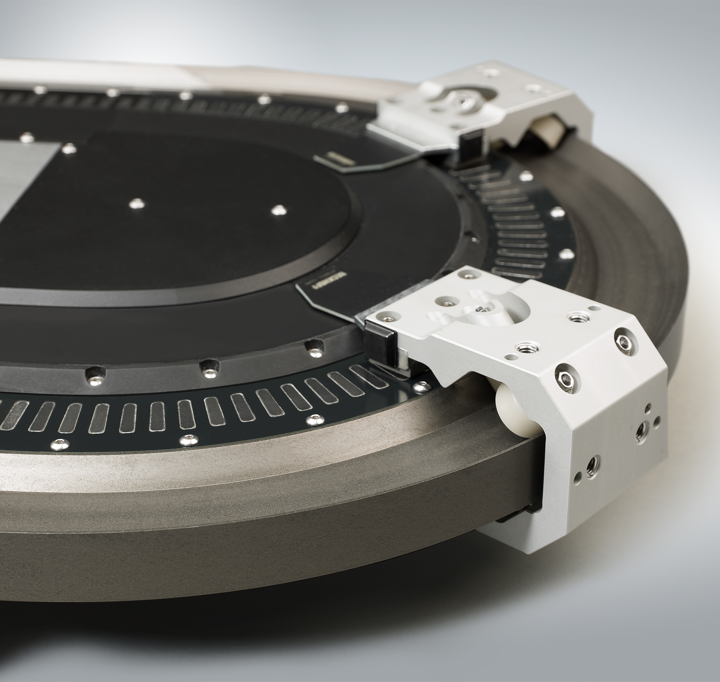
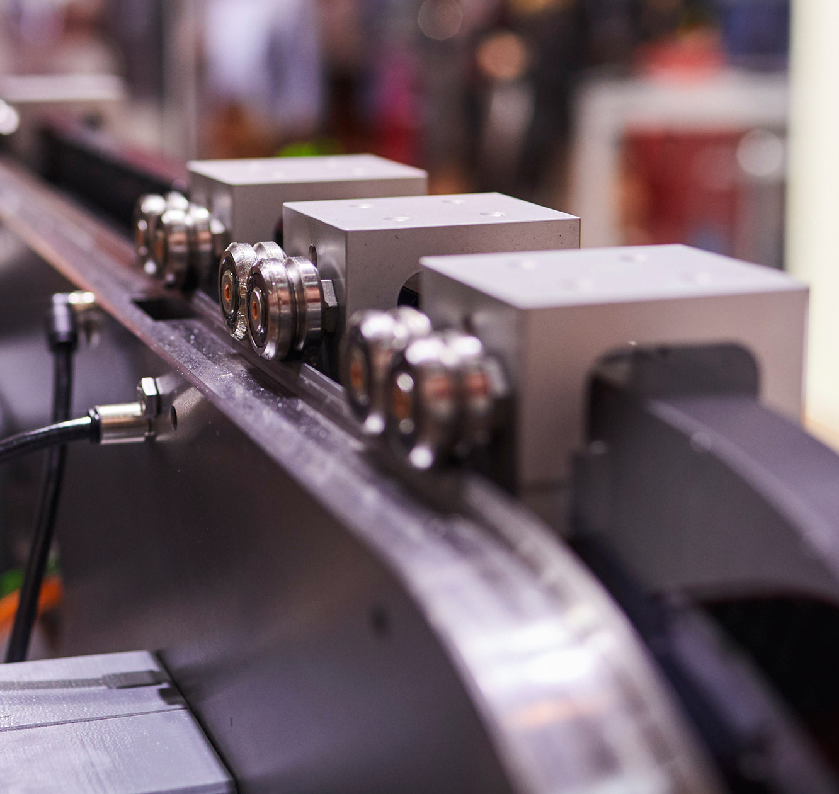
XTS Modules System solution – mover and guide rail
Beckhoff system solution
Guide rail system, mounted parallel with the motor modules

Slide 23
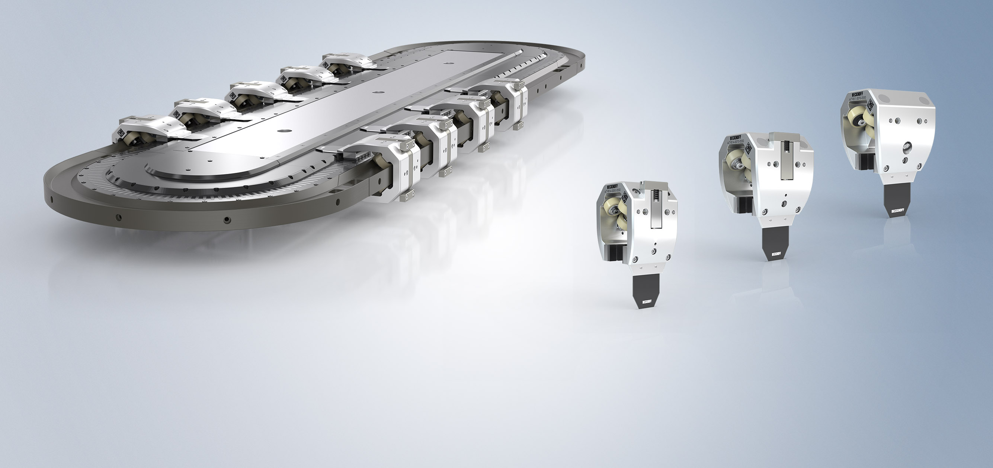
XTS Modules System solution – mover and guide rail
Plastic rollers on aluminum guide rail
no need for constant lubrication
Guide rail mounted on motor module
low total costs
Modular system offers expansion options
flexibly adaptation

Slide 24
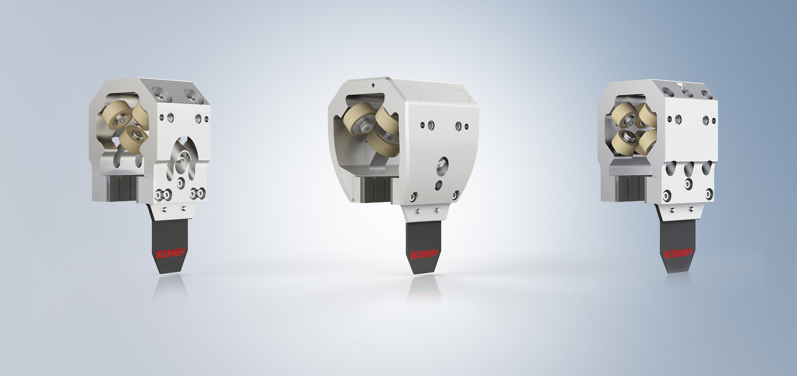
XTS Modules Beckhoff: plastic rollers on aluminium rail
Various product versions for different application requirements
Standard mover
Mover for increased payload
Mover for longer service life

Slide 25

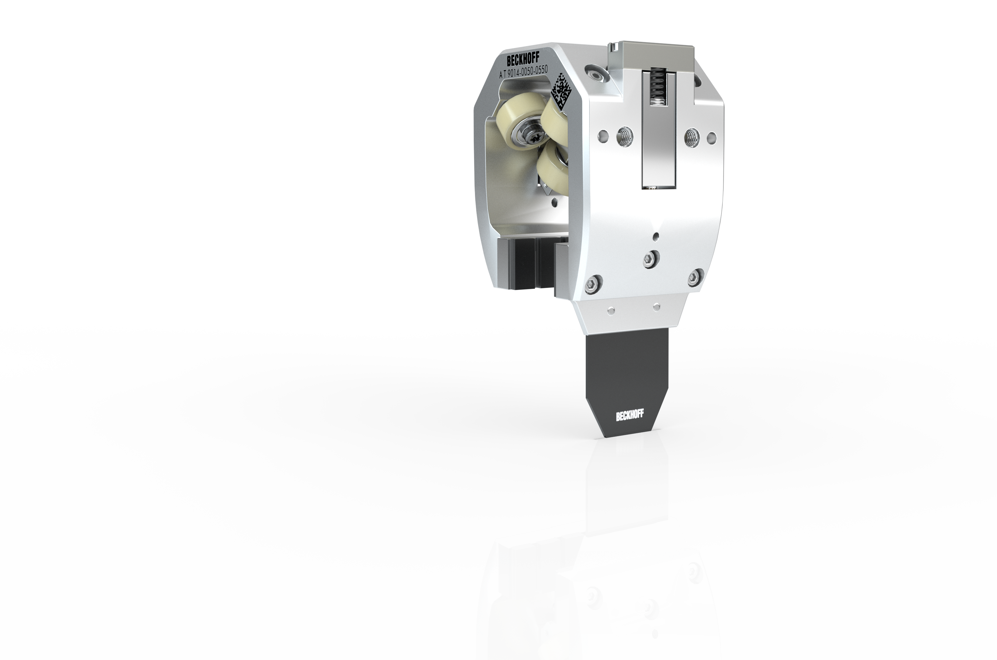
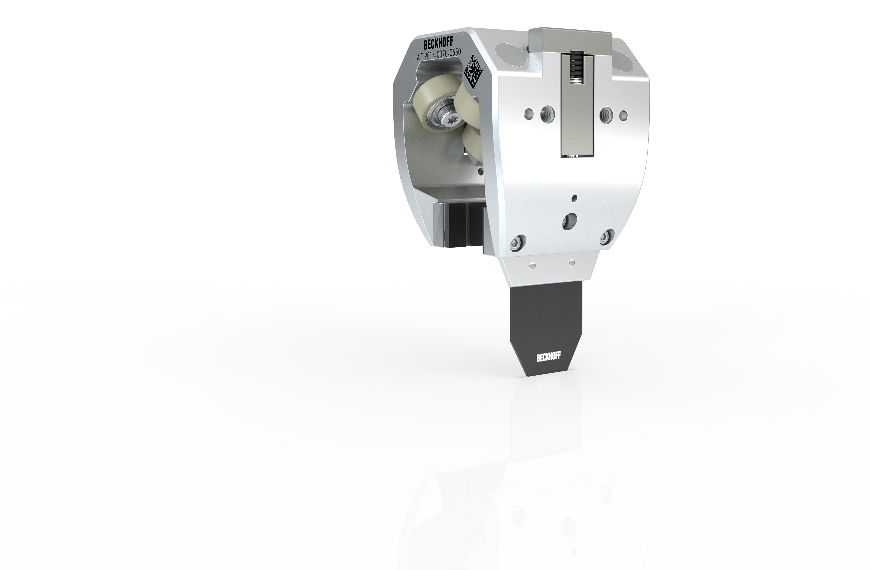

XTS Modules System solution – mover and guide rail
center-to-center distance min. 60 mm
center-to-center distance min. 70 mm
300 g standard payload, even more mass in tests
600 g standard payload, even more mass in tests
300
600
30,000 km mileage with Ø 1.5 m/s during long-term test
25,000 km service life with Ø 1.5 m/s during long-term test

Slide 26
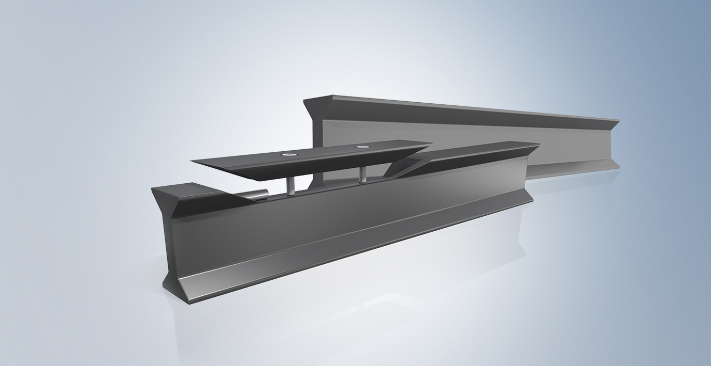
XTS Modules Beckhoff: plastic rollers on aluminum rail
guide rail made of aluminium
straight and curved segments
abrasion-resistant hard anodised aluminium surface
simple assembly of the guide rail via mechanical interface on the motor module
mover with plastic rollers
backlash-free running through optimized geometry
no lubrication necessary
spring-loaded rollers reduce service interval
spring-loaded rollers
rollers
magnetic plates
encoder flag for position feedback

Slide 27
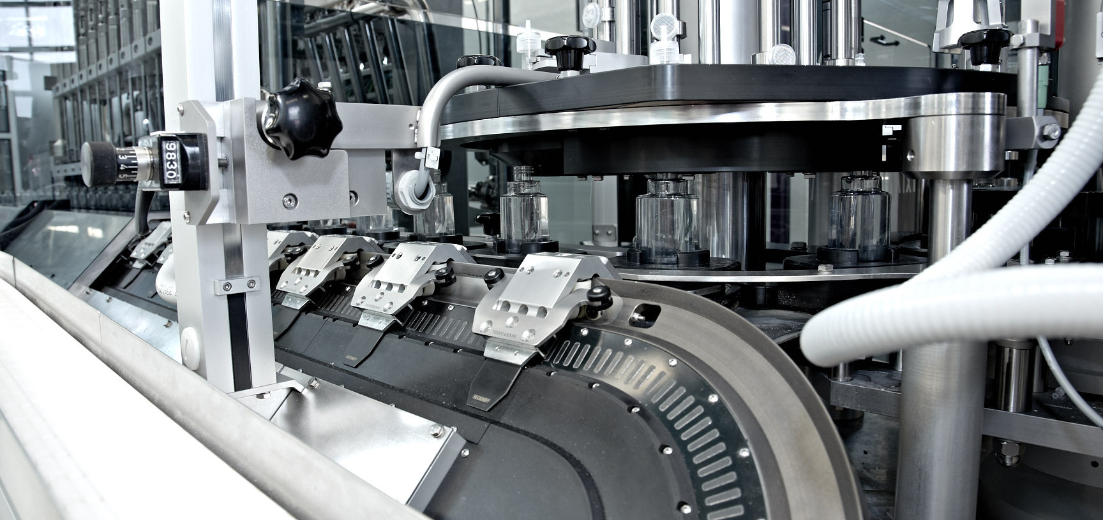
Application example: Cosmetics filling line – Groninger & Co. GmbH, Germany

Slide 28
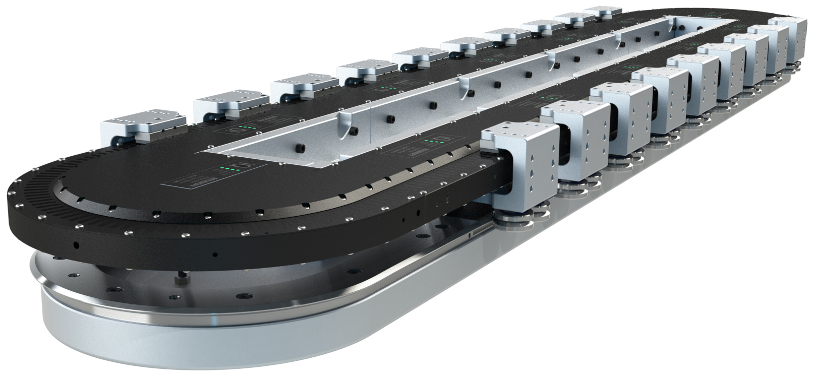
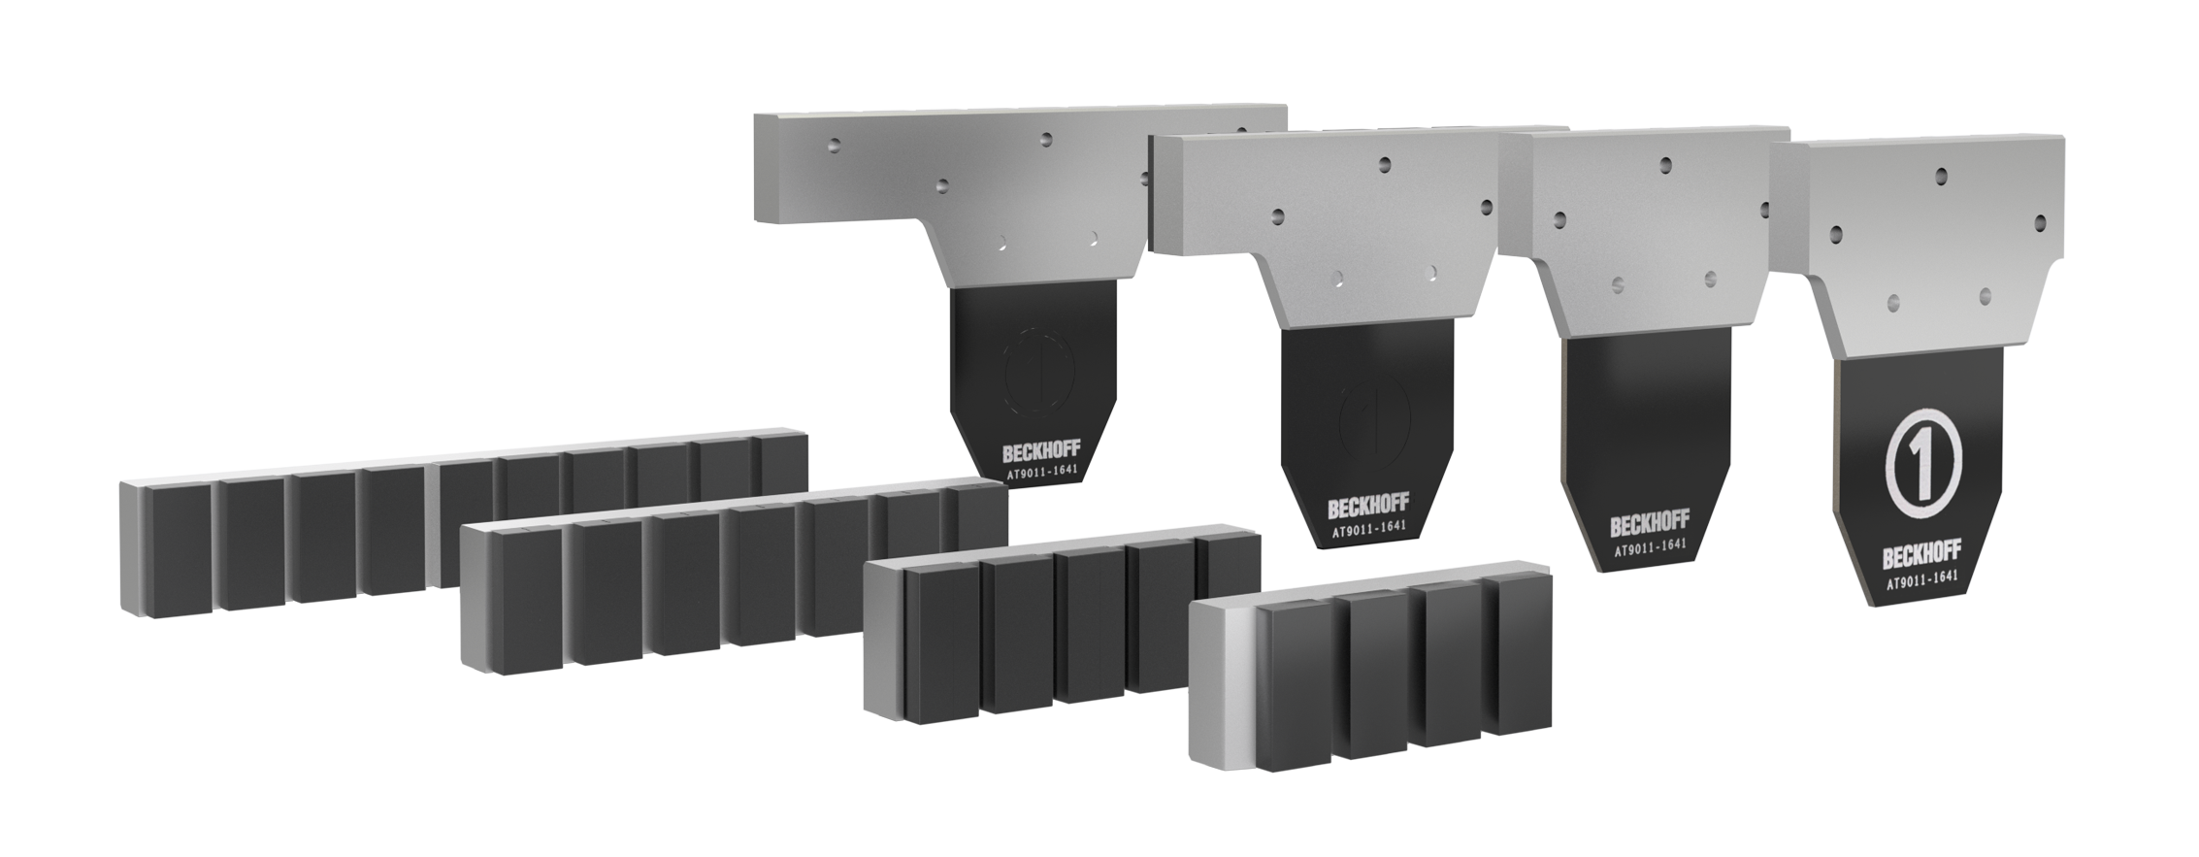
XTS Modules Guide rail system mounted parallel with the motor modules
Parallel guide rail absorbs weight forces
high payloads
Steel rollers on steel guide rail
high durability
Movers with different magnet plate sets
high process forces supported

Slide 29
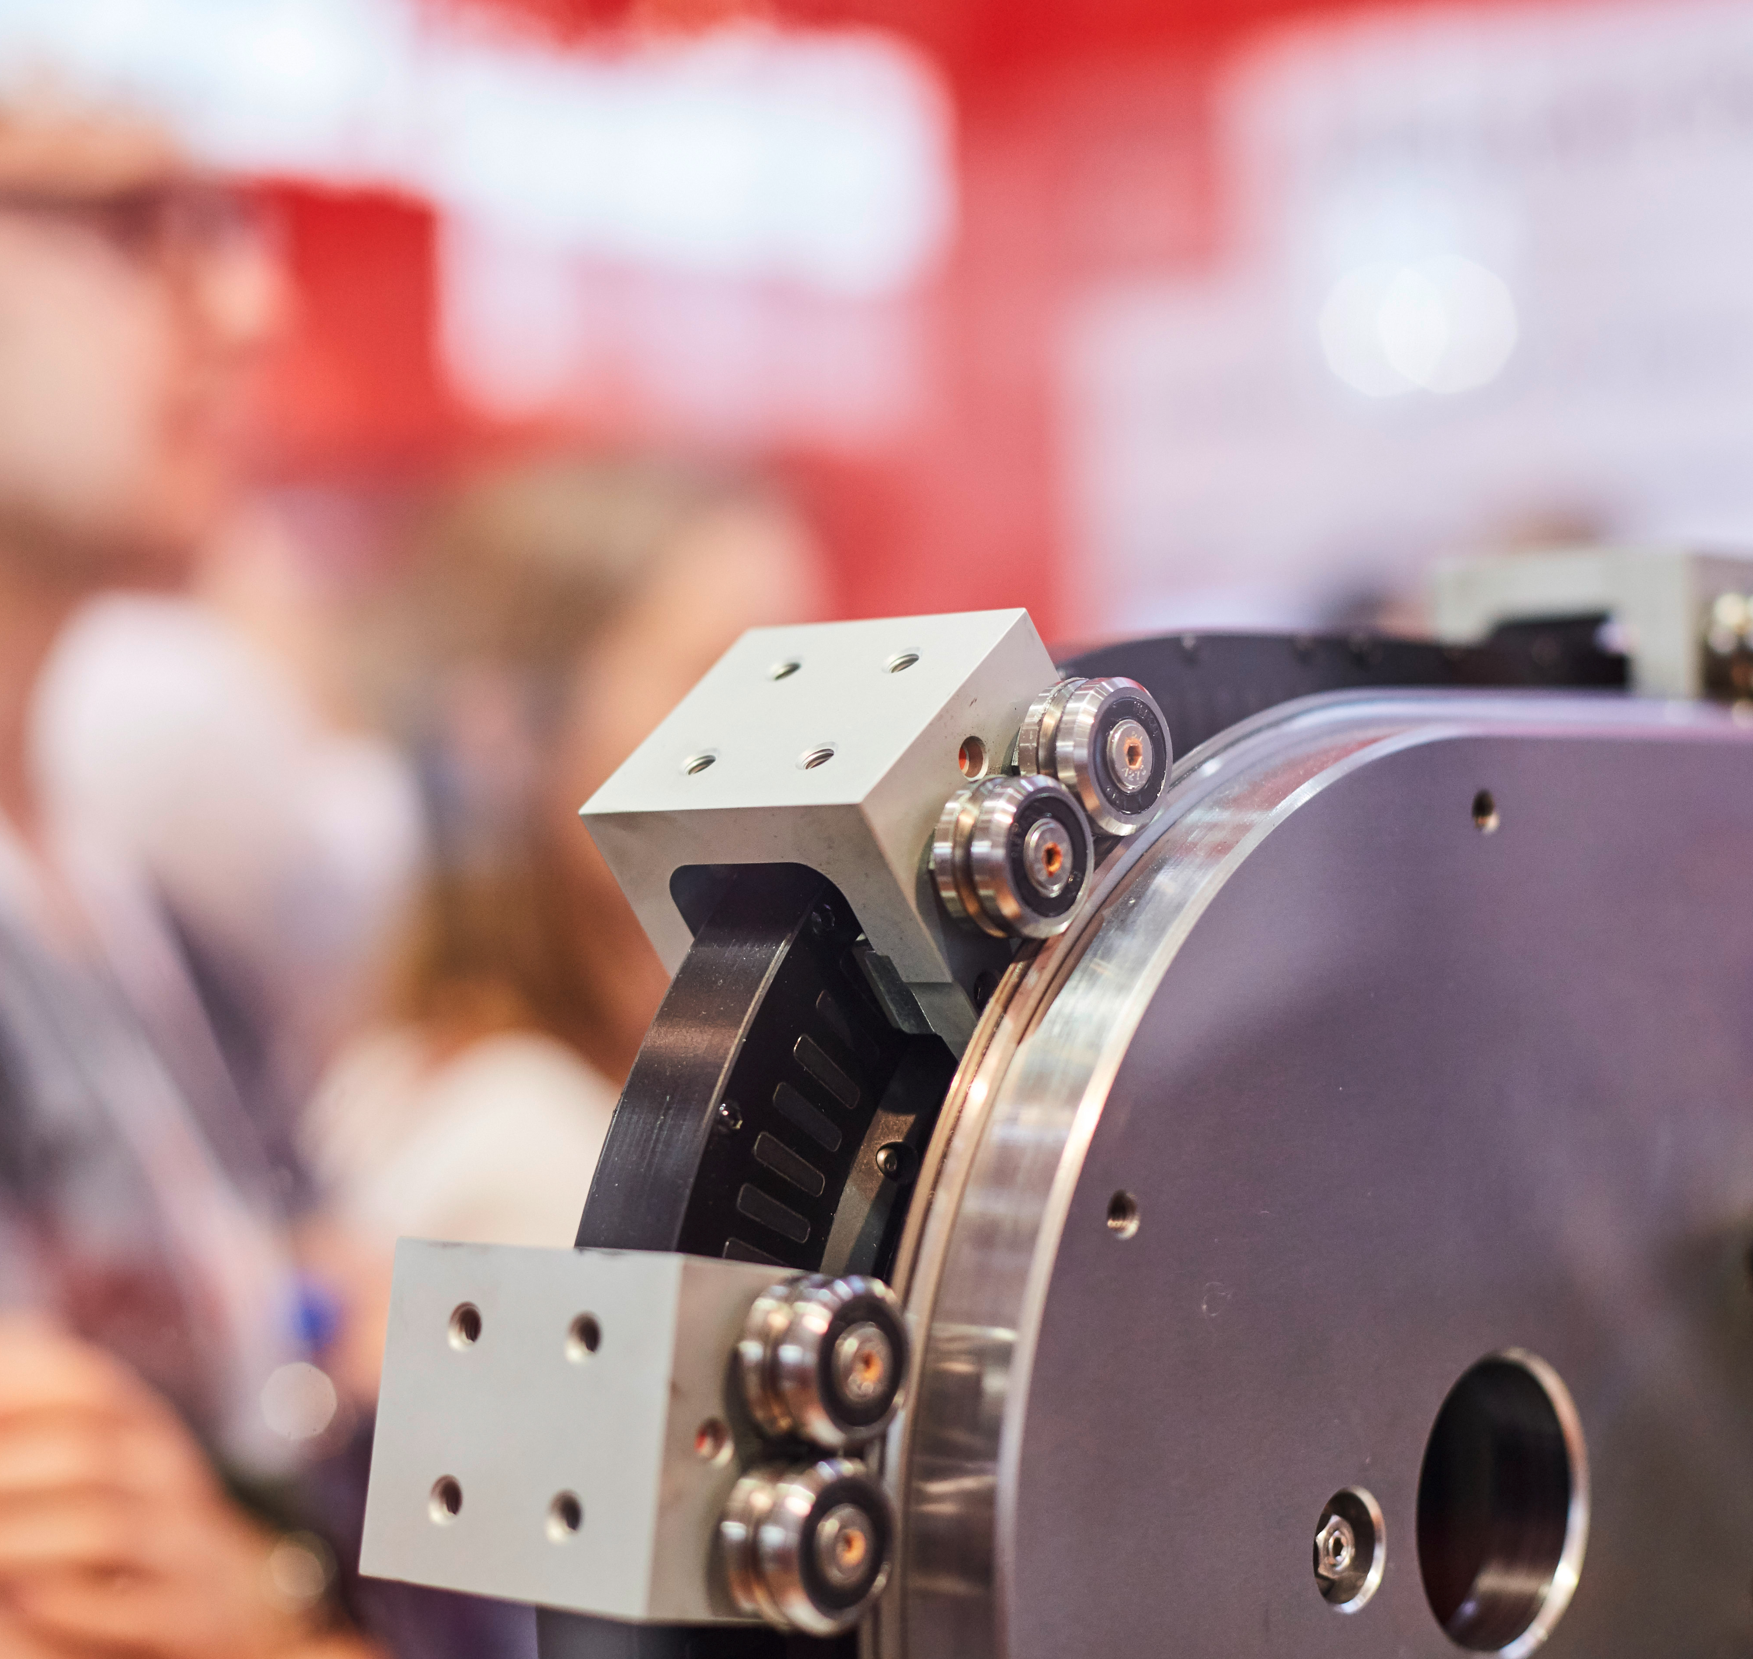
XTS Modules Guide rail system mounted parallel with the motor modules
guidance system routed in parallel to accept higher process forces
hardened steel V-guide to ensure high accuracy over prolonged periods of time
with automatic lubrication system → lubricant is fed to the guide surfaces of the rails
1-track: rail system for 180° curve (clothoid)
PRT2: rail system for round, oval and rectangular systems
motor modules available with upper profile without drill holes
→ increased ease of cleaning

Slide 30
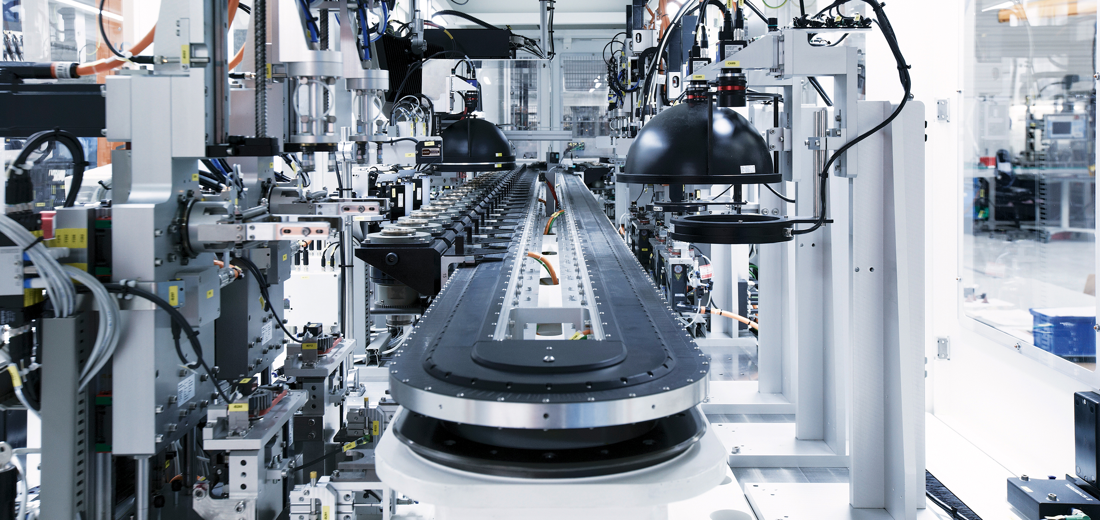
Application example: Optical inspection system – GEFASOFT, Germany
Notes:
GEFASOFT Automatisierung und Software GmbH, Deutschland

Slide 31
XTS Modules guide rail and movers Comparison
Beckhoff system solution
Guide rail system, mounted parallel with the motor modules
highest level of dynamics
low costs
lubricant-free
higher loads
higher process forces
maximised service life

Slide 32
XTS Modules The control system
Straight and curved motor module
Mover
Guide rail
Industrial PC with TwinCAT NC PTP, TwinCAT XTS Extension

Slide 33
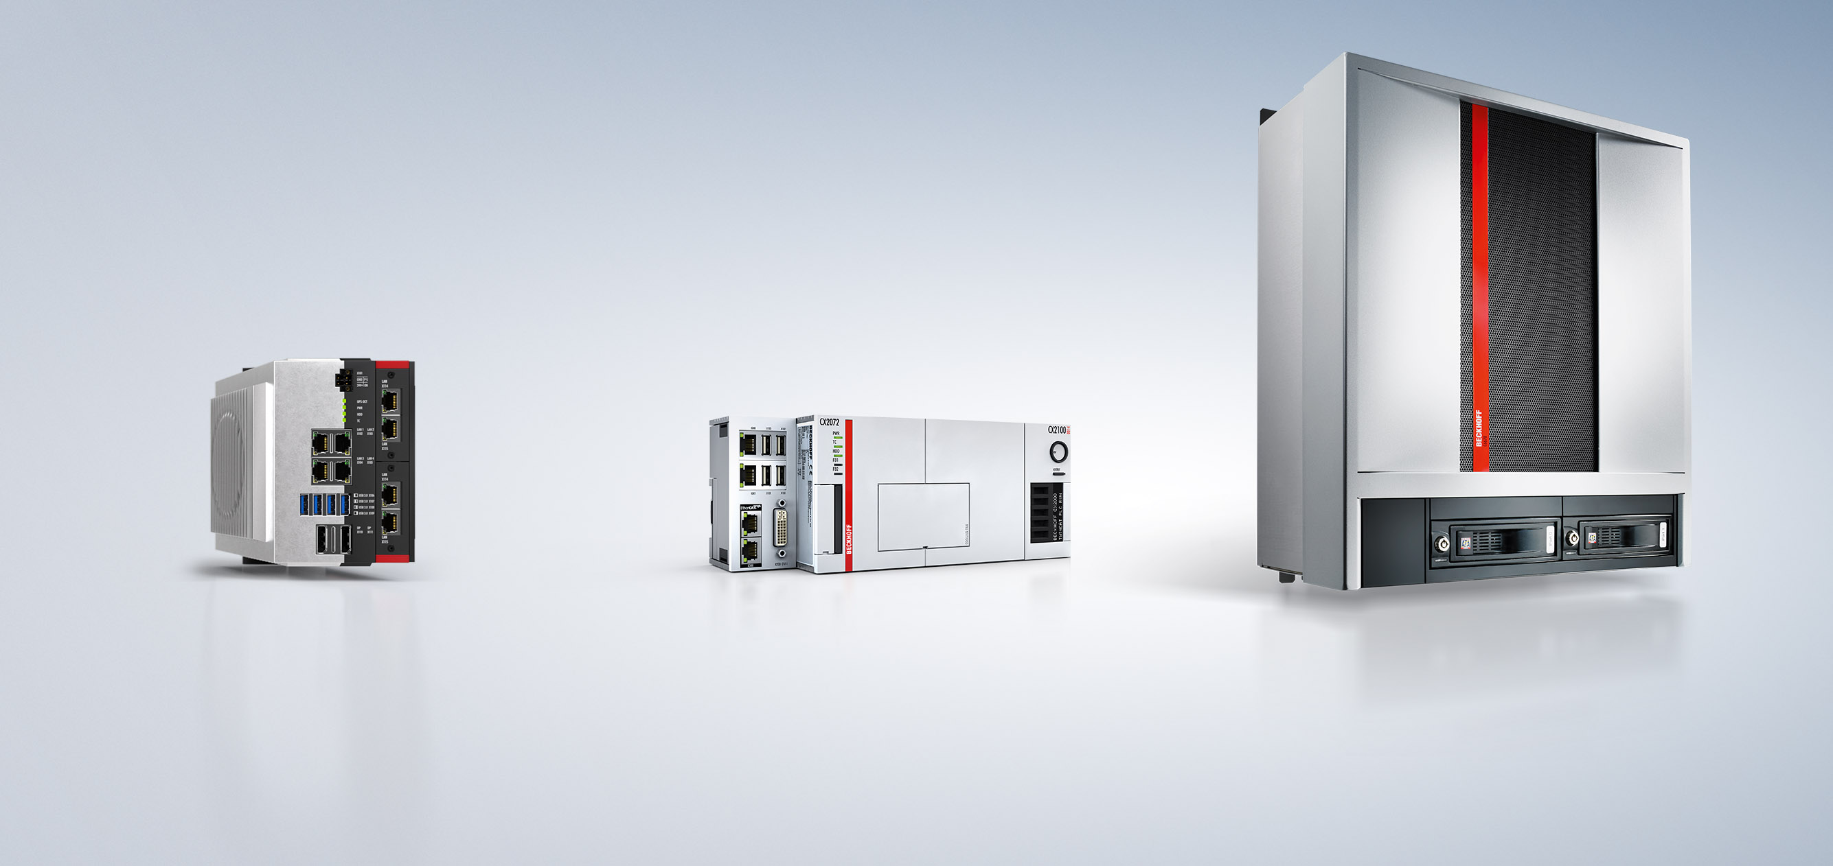
XTS Modules The control system
PC-based control
Data is available centrally (diagnostics, predictive maintenance ...)
PC-based control
real-time coupling between process and hardware
PC-based control
suitable configurations for controlling the overall process

Slide 34

XTS Modules The control system | TwinCAT3

Slide 35




XTS Modules The control system | functions for XTS programming
XTS Extension
Motion Control
HMI
easy handling of desired movements
All motion control functions are available: flying saw, electrical gear unit, cam plates …
functional extensions handle typical XTS requirements
automatic accumulation, collision and jerk avoidance, centrifugal force limitation
creating visualizations with a single mouse click
extensive visualization options with TwinCAT3
Different levels of detail enable easy system diagnostics.

Slide 36

XTS Modules The control system | XTS Extension
XTS software
Integrated simulation functions facilitate plant design
XTS software
Software tools simplify configuration
XTS software
Motion control function blocks reduce engineering effort

Slide 37
XTS Modules The control system | functions for XTS programming
XTS Extension
Application software
NC functions
From the point of view of application programming, a mover appears like a “normal” servo axis
XTS extension
XTS Modules

Slide 38
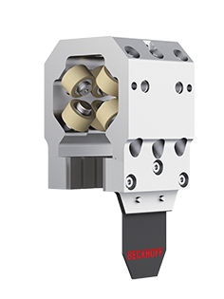
XTS Modules The control system | functions for XTS programming
PC platform
XTS Extension
PLC
TwinCAT Motion Control, PTP
1st axis
2nd axis
m^{th} axis
Virtual connection
The XTS extension in TwinCAT decouples servo algorithms from the hardware components and calculates them centrally.
Mover 1
Mover 2
Mover m

Slide 39
XTS Modules The control system | functions for XTS programming
PC platform
Motion Control
PLC
TwinCAT Motion Control, PTP
1st axis
2nd axis
m^{th} axis
all motion control functions are available, e.g.
flying saw
electrical gear unit
cam plates
Mover 1
Mover 2
Mover m

Slide 40
XTS Modules The control system | functions for XTS programming
PC platform
Motion Control
PLC
TwinCAT Motion Control, PTP
1st axis
2nd axis
m^{th} axis
functional extensions handle typical XTS requirements
automatic accumulation
collision and jerk avoidance
centrifugal force limitation
Mover 1
Mover 2
Mover m

Slide 41
XTS Modules The control system | XTS Extension
The XTS extension in TwinCAT decouples servo algorithms from the hardware components and calculates them centrally.
PC platform
PLC
TwinCAT Motion Control, PTP
1st axis
2nd axis
m^{th} axis
Virtual connection
Mover 1
Mover 2
Mover m

Slide 42
XTS Modules The control system | XTS Extension
From the point of view of application programming, a mover appears like a “normal” servo axis
all motion control functions are available, e.g.
flying saw
electrical gear unit
cam plates
functional extensions handle typical XTS requirements
automatic accumulation
collision and jerk avoidance
centrifugal force limitation
Application software
NC functions
XTS extension
XTS Modules

Slide 43

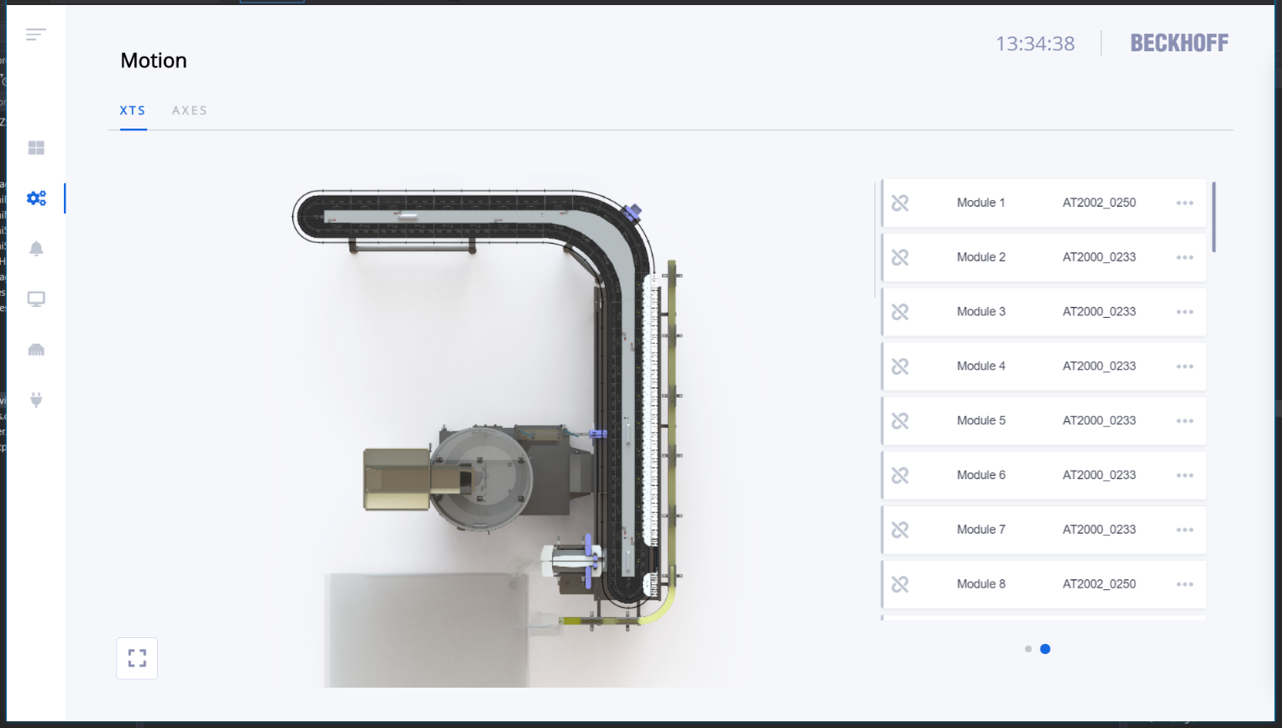
XTS Modules The control system | HMI Control
HMI
XTS HMI Control offers visualization options for the machine operator

Slide 44
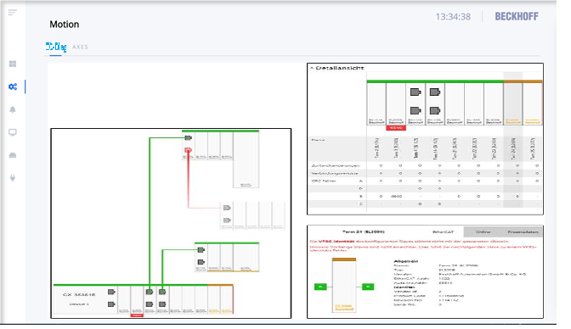
XTS Modules The control system | HMI Control
HMI
EC-Diag HMI Control offers visualization options for the machine operator

Slide 45
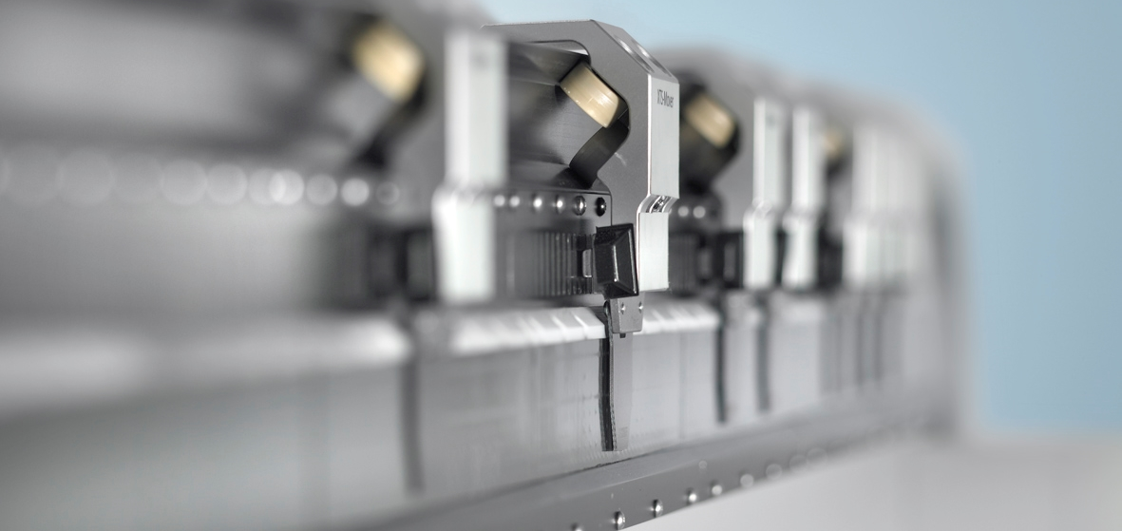
XTS | New Freedom in Machine Building
Complex sequences – simplified solution: XTS

Slide 46
Training material
This training material is provided to complement the presented training content. Outside the actual training the material may only be used for internal purposes at the company of the course participant. In addition, the material or extracts thereof may be used in end customer training for products containing Beckhoff products, or for presentations, provided the presentation refers to Beckhoff products. Extracts or copies of the training material must contain the following copyright acknowledgement: “© Beckhoff Automation GmbH & Co. KG”.
The same applies to extracts from presentation material. The user of the material is solely responsible for the completeness of extracts and copies. It is explicitly not permitted to offer commercial or free training for Beckhoff products. This applies to training with and or without the training material. The training material must not be edited, manipulated or modified.
Passing on of the aforementioned rights to third parties is not permitted.
Beckhoff Automation GmbH & Co. KG

Slide 47
02/2021

